Slide 1
Foundations of Vibration Analysis:
A Comprehensive Introduction

Slide 2
Introduction:
Importance of Vibration Analysis:
Forms a solid background for analyzing problems in rotating machinery
Time and Frequency Domain Analysis:
Commonly switch between time and frequency domains for analysis
Frequency spectrum is derived from time domain data
Relation between time and frequency domain is important
Units and Terminology
Typical units: acceleration, velocity and displacement
Additional terms: peak-peak, peak and RMS(root mean square)
Training Criteria
Established by the vibration institute

Slide 3
Mass and Stiffness
All machines can be broken down into two specific categories:
MASS is represented by an object that wants to move or rotate
STIFFNESS is represented by springs or constraints of that movement
Relation between mass and stiffness:
fn = 1/2П k/m
Where:
fn = natural frequency (Hz)
k = stiffness (lb / in)
m = mass & mass = weight / gravity

Slide 4
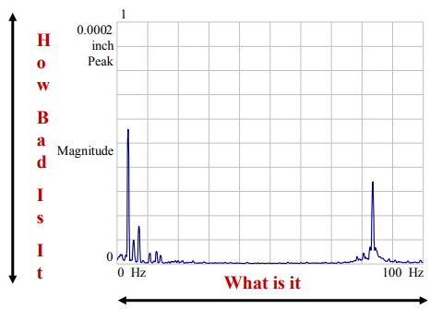
Spectrum Analysis
Spectrum: Represents the signal's frequency components.
FFT (Fast Fourier Transform): Algorithm to compute the discrete Fourier transform (DFT) efficiently.
Frequency Spectrum: Shows signal amplitude versus frequency.
Power Spectrum: Displays power per frequency component.
Scaling:
X-axis (Frequency): "What is it?"
Y-axis (Amplitude): "How bad is it?"

Slide 5
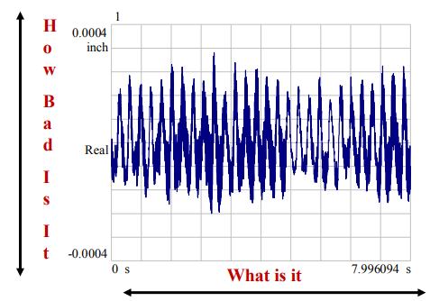
Time Waveform & Its Scaling
What is it? A time waveform represents a signal's variation over time.
X-Axis (Time): Shows the time progression of the signal.
Y-Axis (Amplitude): Indicates the signal's intensity, reflecting "how bad is it?"

Slide 6
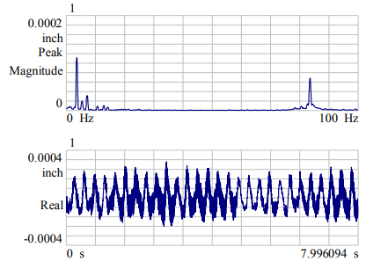
Time and Frequency Double Trouble
Double Trouble: Problems can exist simultaneously in both the time and frequency domains, making it challenging to diagnose and analyze signal issues accurately.

Slide 7
The X- Scale
The X Scale – Hertz (Hz)
1 Hertz (Hz) = 1 cycle/second (cps)
Frequency in vibration analysis is often expressed in cycles/minute (cpm):
60 cpm = 1 cps = 1 Hz
Frequency (F) and Time (T) Relationship:
F(Hz)=1/T(s)​ and T(s)=1/F(Hz)
FT=1 (If F increases, T decreases and vice versa)

Slide 8
The X-Scale in Vibration Analysis
Single Frequency: One specific frequency component (e.g., 1 Hz).
Multiple Frequencies: Combination of different frequency components.
Multiple Time: Multiple time intervals corresponding to different frequencies.
Real Life Time: Actual time over which vibrations are measured.
Frequency Spectrum: Graph showing amplitude vs. frequency, illustrating all frequency components present.

Slide 9
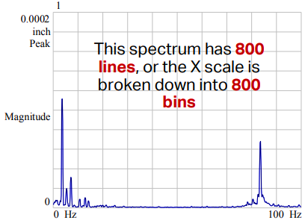
The X Scale – Lines or Bins
The FFT has a defined number of lines or bins.
Common choices include:
100 lines
200 lines
400 lines
800 lines
1600 lines
3200 lines

Slide 10
The X Scale – Filter Windows (Continued)
Purpose of Window Filters:
Applied to time waveform data to simulate data starting and stopping at zero.
Can cause errors in both the time waveform and frequency spectrum.

Slide 11
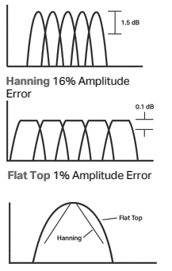
Types and Recommended Uses
Window Filters:
Hanning: Used for frequency analysis (16% amplitude error).
Flat Top: Used for calibration and accuracy (1% amplitude error).
Uniform: No window, used for bump testing and resonance checks.
Force Exponential: Used for frequency response.

Slide 12
Practical Recommendations
Best Practices:
Hanning Window: Ideal for normal vibration monitoring (frequency).
Flat Top Window: Suitable for precise calibration and accuracy (amplitude).
Uniform Window: Recommended for bump testing and resonance checks.

Slide 13
THE X SCALE – LRF
The Lowest Resolvable Frequency is determined by:
Frequency Span / Number of Analyzer Lines (data points)
The frequency span is calculated as the ending frequency minus the starting frequency.
The number of analyzer lines depends on the analyzer and how the operator has set it up.
Example: 0 – 400 Hz using 800 lines
Answer: (400 – 0) / 800 = 0.5 Hz / Line

Slide 14
THE X SCALE – BANDWITH
The Bandwidth can be defined by:
(Frequency Span / Analyzer Lines) Window Function
Uniform Window Function = 1.0
Hanning Window Function = 1.5
Flat Top Window Function = 3.8
Example: 0 - 400 Hz using 800 Lines & Hanning Window
Answer: (400 / 800) 1.5 = 0.75 Hz / Line

Slide 15
THE X SCALE – RESOLUTION
The Frequency Resolution is defined in the following manner:
2 (Frequency Span / Analyzer Lines) Window Function
-OR
Resolution = 2 (Bandwidth)
Example: 0 - 400 Hz using 800 Lines & Hanning Window
Answer: 2 (400 / 800) 1.5 = 1.5 Hz / Line

Slide 16
THE X SCALE – USING RESOLUTION
Measuring Close Frequency Disturbances
Objective: Determine the frequency span required to accurately measure two close frequency disturbances using a Hanning Window and 800 lines.
Frequencies to Measure: Frequency #1: 29.5 Hz Frequency #2: 30 Hz
Resolution Required: 30 Hz−29.5 Hz=0.5 Hz
Formula for Resolution with Window Function:
Resolution=2×(Frequency Span/Analyzer Lines)×Window Function
Given: Resolution Required: 0.5 Hz, Analyzer Lines: 800, Window Function (Hanning): 1.5
Plugging Values into the Formula:
0.5=2×(Frequency Span/800)×1.5
Frequency Span≈133.33 Hz

Slide 17
THE X SCALE – DATA SAMPLING TIME
Objective: Determine the data sampling time required to take one record or sample of data.
Key Concepts:
Data Sampling Time (TSample): The amount of time required to take one record or sample of data.
Dependent on:
Frequency Span (Fspan)
Number of Analyzer Lines (Nlines)
Formula for Data Sampling Time: TSample=Nlines/Fspan
Given Values: Analyzer Lines (Nlines): 400,Frequency Span (Fspan): 800 Hz
Calculation:
TSample=400/800=0.5 seconds

Slide 18
THE X SCALE – AVERAGE AND OVERLAP
Average:
On: Averaging is enabled to improve the accuracy and stability of the measurements by reducing random noise.
Overlap Percent:
50%: Overlapping means that 50% of the data from one sample is reused in the next sample.
Visual Representation:
Sample 1: Start→Data 1, Data 2, Data 3, ..., Data N/2\text{Start} \rightarrow \text{Data 1, Data 2, Data 3, ..., Data N/2}Start→Data 1, Data 2, Data 3, ..., Data N/2
Sample 2: Data N/2, Data N/2+1, ..., Data N\text{Data N/2, Data N/2+1, ..., Data N}Data N/2, Data N/2+1, ..., Data N

Slide 19
How long will it take for 10 averages at 75% overlap using a 800 line analyzer and a 200 Hz frequency span?
10 Averages
75% Overlap
800 Lines
200 Hz
Average #1 = 800 / 200 Average #1 = 4 seconds Average #2 - #10 = (4 x 0.25)
Average #2 - #10 = 1 second each
Total time = 4 + (1 x 9) Total time = 13 second

Slide 20
The Y Scale – Amplitude
Understanding the Y Scale:
The “Y” scale provides the amplitude value for each signal or frequency.
Default units for the “Y” scale are volts RMS.
Volts is an Engineering Unit (EU).
Three suffixes for amplitude:
RMS (Root Mean Square)
Peak (Pk)
Peak-to-Peak (Pk-Pk)

Slide 21
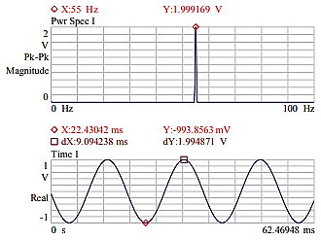
Y Scale – PK-PK (Peak-to-Peak):
Definition: Expressed from the peak to peak amplitude.
Spectrum Suffix: "Pk-Pk".
Visual Example:

Slide 22
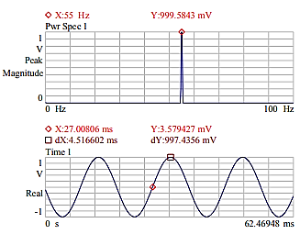
Y Scale – PK (Peak):
Definition: Expressed from zero to the peak amplitude.
Spectrum Suffix: "Peak".
Visual Example:

Slide 23
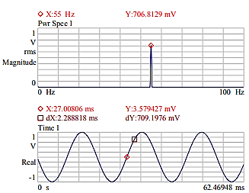
Y Scale – RMS (Root Mean Square):
Definition: Expressed from zero to 70.7% of the peak amplitude.
Spectrum Suffix: "RMS".
Visual Example:
Note: The time wave remains unchanged across all scales.

Slide 24
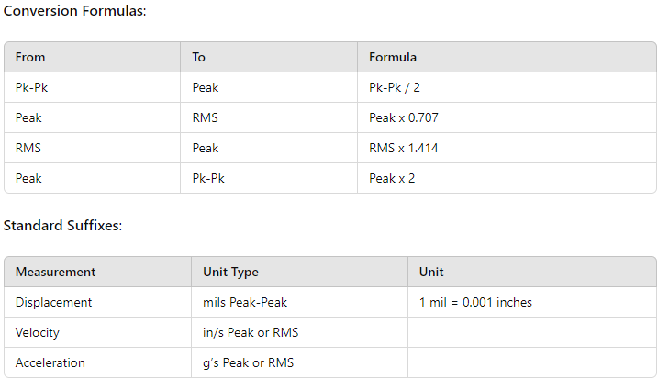
The Y Scale – Changing Suffixes & Standard Suffixes
Changing Suffixes
Pk-Pk to Peak: Pk-Pk/2=Peak
Peak to RMS: Peak×0.707=RMS
RMS to Peak: RMS×1.414=Peak
Peak to Pk-Pk: Peak×2=Pk-Pk
Standard Suffixes (Vibration Institute)
Displacement: mils Peak-Peak
Velocity: in/s Peak or RMS
Acceleration: g’s Peak or RMS
Note: 1 mil = 0.001 inches

Slide 25
The Y Scale – Engineering Units (EU)
Setting Up EUs
If EUs are not set up, use the known EU for your sensor to convert measurements.
Example Conversion:
Sensor Output: 100 mV / g
Measured Peak: 10 mV
Amplitude in g's:Amplitude (g)=10 mV/100 mV/g=0.1 g
Key Takeaway
EUs translate sensor outputs into meaningful physical quantities, ensuring accurate and understandable measurements.
Engineering units (EUs) provide meaningful measurements, converting volts to more useful units.
Examples of EUs:
100 mV / g
20 mV / Pa
1 V / in/s
200 mV / mil
50 mV / psi
10 mV / fpm
33 mV / %
10 mV / V

Slide 26
The Y Scale – The Big Three EUs
Acceleration
Velocity
Displacement
Converting the Big Three
Common Scenario: Measurement in one unit (e.g., acceleration) but model/specifications in another (e.g., displacement or velocity).
Need: Ability to convert between these units.
The Y Scale – 386.1 Conversion
1 g = 32.2 feet/second²
32.2 feet/second² = 386.1 inches/second²/g

Slide 27
THE Y SCALE – GO WITH THE FLOW I

Slide 28
THE Y SCALE – METRIC GO WITH THE FLOW I

Slide 29
THE Y SCALE – GO WITH THE FLOW II

Slide 30
THE Y SCALE – DOING THE MATH UNITS
Acceleration to Velocity
Given: 0.5g vibration at 25 Hz
Calculation: Velocity=0.5×386.1/2π×25≈1.23 inches/second
RMS Acceleration to Peak Velocity
Given: 7 mg RMS at 25 Hz
Calculation:
Velocity (RMS)=0.007×386.1/6.28×25≈0.017 inches/second RMS
Peak Velocity=0.017×1.414≈0.024 inches/second Pk
Velocity to Displacement
Given: 0.024 in/s Peak at 25 Hz
Calculation: Displacement (Pk)=0.024/6.28×25≈0.000153 inches Pk
Displacement (Pk-Pk)=0.000153×2≈0.000306 inches Pk-Pk
Acceleration to Displacement
Given: 15 mg RMS at 52 Hz
Calculation: Displacement (RMS)=0.015×386.1/(6.28×52)^2≈0.000054 inches RMS
Displacement (Pk-Pk)=(0.000054×1.414)×2≈0.000154 inches Pk-Pk

Slide 31
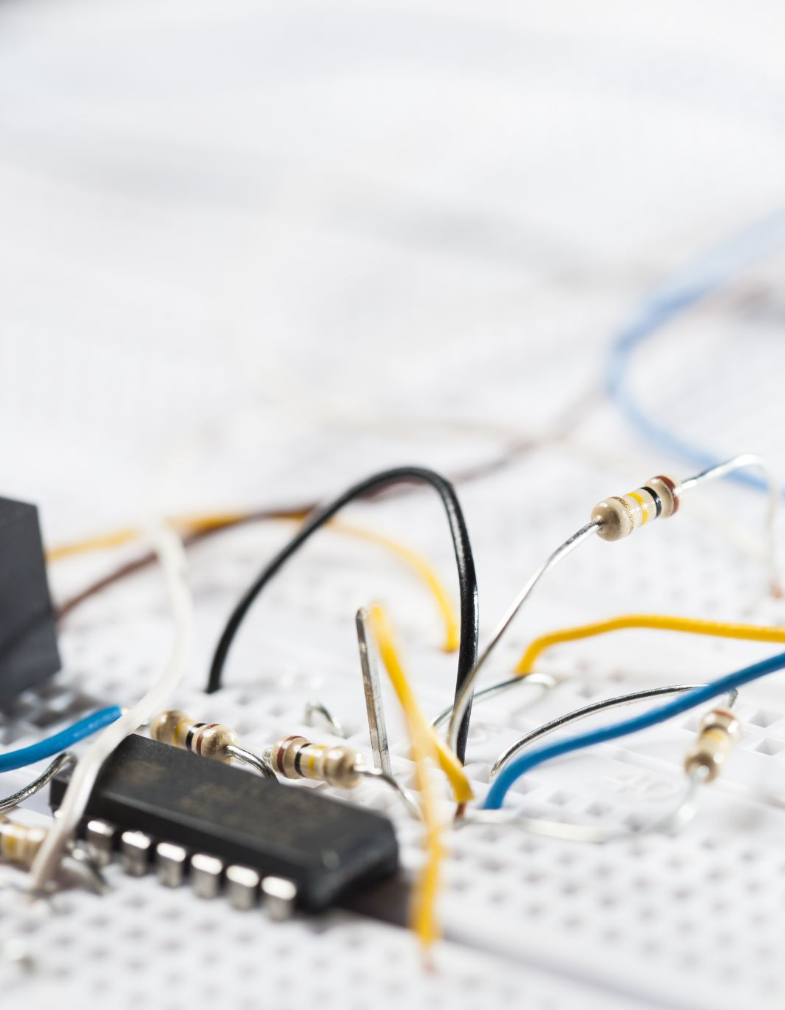
Sensors and Accelerometers
Sensors: Devices that detect and measure physical properties, converting them into signals for monitoring and analysis.
Accelerometers: Specific sensors used in vibration analysis to measure acceleration, providing data on the frequency and amplitude of vibrations in machinery.

Slide 32
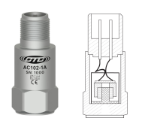
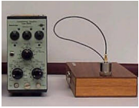
Sensors – Accelerometers
Integrated Circuit:
Contains built-in electronics, ideal for industrial applications.
Charge Mode:
Uses a charge amplifier, suited for precise test and measurement scenarios.

Slide 33
Sensors – Accelerometers
Advantages
Disadvantages
Measures casing vibration
Measures absolute motion
Can integrate to velocity output
Easy to mount
Large range of frequency response
Available in many configurations
Does not measure shaft vibration
Sensitive to mounting techniques and surface conditions
Difficult to perform calibration check
Double integration to displacement often causes low-frequency noise
One accelerometer does not fit all applications

Slide 34
SENSORS – MASS AND CHARGE

Slide 35
SENSORS – ACCELEROMETER CONSTRUCTION
Faraday shield
Insulating material
Stainless Steel 316L housing with ¼-28 threaded mounting
2, 3,or 4 pin military connector
Hermetically sealed welded seam
PC Board
Mass
PZT ceramic
Pedestal (post)

Slide 36
SENSORS – ACCELEROMETER OPERATION
Mass remains at rest
PZT ceramic is in shear
Pedestal (post) transmits vibration

Slide 37
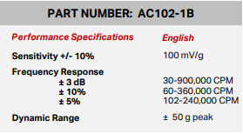
SENSORS – ACCELEROMETER PARAMETERS
Performance suited for application
Sensitivity (mV/g)
Frequency response of target (f span)
Dynamic range of target (g level)

Slide 38
SENSORS – MOUNTING THE ACCELEROMETER

Slide 39
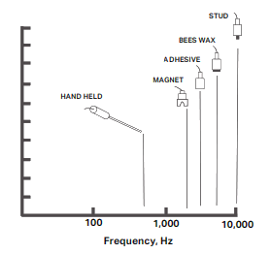
SENSORS – REALISTIC MOUNTING
In the real world, mounting might not be as good as the manufacturer had in the lab!
What happened to the high frequency?

Slide 40
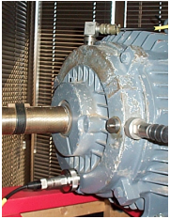
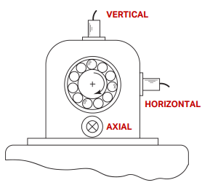
SENSORS – MOUNTING LOCATION
Load zone
Radial
Vertical
Horizontal
Axial

Slide 41
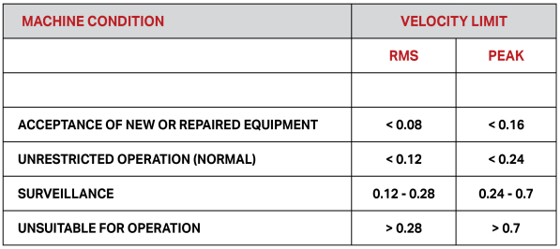
SENSORS – ACCELEROMETER ALARMS
Note 1: The rms velocity (in/sec) is the band power or band energy calculated in the frequency spectrum
Note 2: The peak velocity (in/sec) is the largest positive or negative peak measured in the time waveform

Slide 42
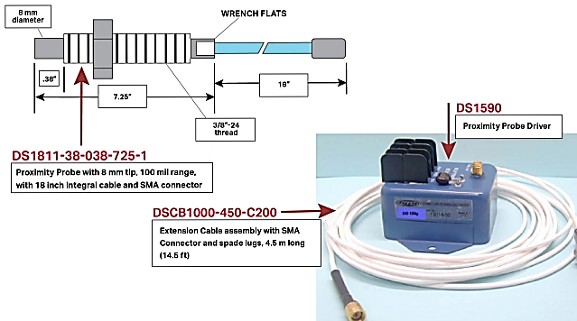
SENSORS – PROXIMITY PROBES
Proximity Probes: Proximity probes, also known as eddy current sensors, measure the distance between the probe tip and a conductive surface, providing precise and non-contact monitoring of position, displacement, or vibration in machinery and equipment. They are essential for condition monitoring and maintenance in various industrial applications.

Slide 43
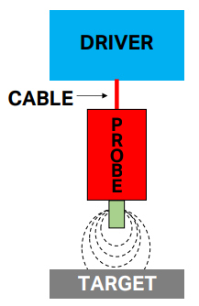
SENSORS – PROXIMITY PROBE THEORY
The tip of the probe broadcasts a radio frequency signal into the surrounding area as a magnetic field.
If a conductive target intercepts the magnetic field, eddy currents are generated on the surface of the target, and power is drained from the radio frequency signal.
As the power varies with target movement in the radio frequency field, the output voltage of the driver also varies.
A small dc voltage indicates that the target is close to the probe tip.
A large dc voltage indicates that the target is far away from the probe tip.
The variation of dc voltage is the dynamic signal indicating the vibration or displacement.

Slide 44
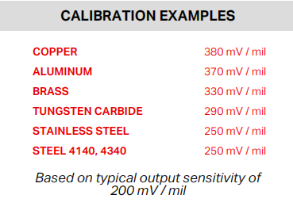
SENSORS – OUTPUT VALUES
Typical
100 mV / mil
200 mV / mil
Depends on probe, cable (length), and driver
Target material varies output

Slide 45
SENSORS – PROXIMITY PROBE
ADVANTAGES
DISADVANTAGES
Non-contact: No physical contact required.
Dynamic & Static Measurement: Measures shaft dynamic motion and static position (gap).
Frequency Response: Flat response from DC to 1 KHz.
Simple Calibration: Easy to calibrate.
Durability: Suitable for harsh environments.
Vibration: Probe can vibrate.
Material Limitations: Not effective on all metals.
Accuracy Issues: Plated shafts may yield false readings; measures nicks and tool marks.
Replacement: Entire unit (probe, cable, driver) must be replaced.
Installation Requirements: Needs relief at sensing tip from surrounding metal.

Slide 46
SENSORS – TYPICAL MOUNTING

Slide 47
SENSORS – LOOKING AT ORBITS

Slide 48
SENSORS – THE ORBIT DISPLAY

Slide 49
SENSORS – UNBALANCE WITH ORBIT

Slide 50
SENSORS – MISALIGNMENT WITH ORBIT

Slide 51
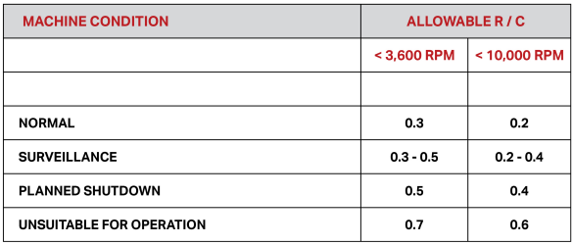
SENSORS – PROXIMITY PROBE ALARMS
Note 1: R is the relative displacement of the shaft measured by either probe in mils peak-peak
Note 2: C is the diametrical clearance (difference between shaft OD and journal ID) measured in mils

Slide 52
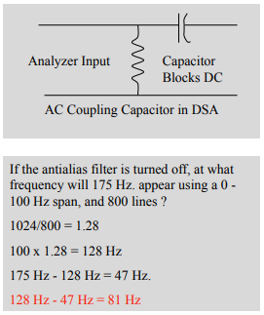
SENSORS – ANALYZER INPUT – FRONT END
Coupling:
AC Coupling:
Blocks DC voltage
Amplitude error below 1 Hz
DC Coupling:
No error below 1 Hz
Analyzer must range on total signal amplitude
Antialias Filter:
On/Off:
Prevents higher frequencies from wrapping into the spectrum

Slide 53
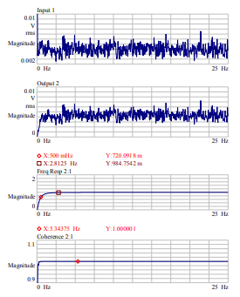
SENSORS – LOW END FREQUENCY RESPONSE
Ensures accurate measurement of low-frequency signals, critical for detecting slow-moving or subtle changes. Proper coupling (AC/DC) affects accuracy, with DC coupling avoiding errors below 1 Hz.

Slide 54
DATA COLLECTION - DATA COLLECTOR ‘ROTATING EQUIPMENT’
Route based
Frequency spectrum
Time waveform
Orbits q Balancing
Alignment
Data analysis
History
Trending
Download to PC
Alarms
’Smart’ algorithms

Slide 55
THANK YOU!
Do you have any questions?
youremail@gmail.com
+92-xxxxxx-yy
www.yourwebsite.com
@yourusername

