Slide 1
BASICS OF ACCELEROMETER MOUNTING AND INSTALLATION
(Level 2: Lesson 1)

Slide 2
Introduction
Definition of Accelerometers:
Devices that measure acceleration forces, essential for various applications such as vibration
monitoring, motion detection, and navigation systems.
Importance of Proper Mounting and Installation:
Ensures accurate and reliable measurements.
Prevents signal distortion and mechanical damage.
Overview of Topics Covered:
Different types of accelerometer mounts.
Step-by-step installation procedures.
Common mounting errors and how to avoid them.
Maintenance tips for long-term performance.

Slide 3
MOUNTING - OBJECTIVES
Lesson Objectives:
Understand the advantages and disadvantages of various mounting methods for accelerometers and Piezo velocity sensors.
Learn to choose appropriate hardware and techniques based on data requirements for specific applications.
Installation Techniques Reviewed:
Stud Mount
Adhesive Mount
Portable Mount

Slide 4
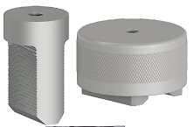
MOUNTING – 4 MOUNTING STYLES
There are 4 general categories of mounting styles which we will focus on:
MAGNET MOUNT with a curved-surface magnet
SPECIALTY MOUNTING PADS such as motor fin mount pads
EPOXY PADS including quick connect studs, targets for flat magnets, and permanent mounting studs
STUD MOUNT

Slide 5
MOUNTING – ADVANTAGES AND LIMITATIONS
General Considerations and Rating System
Advantages and Disadvantages:
Minimal mass (weight).
Maximize surface area contact.
Maximize stiffness (firm attachment).
Proximity to the vibration source.
Rating System:
FAIR
GOOD
BETTER
BEST

Slide 6
MOUNTING – ADVANTAGES AND LIMITATIONS
Portable Mounting
Curved Surface (2-bar) Magnet:
Rating: FAIR
Higher mass, less surface contact.
Reliable data up to 2 kHz (120,000 CPM).
Flat Magnet on Target:
Rating: GOOD to BEST
Lower mass, better surface contact.
Reliable data up to 8-10 kHz (600,000 CPM).
Quick Connect System:
Rating: GOOD to BEST
Repeatable data collection (same point, same angle).
Portable or Permanent Mounting
Specialty Mounts (e.g., Grease Fitting Mounts, Motor Fin Mount Pads):
Rating: GOOD
Moderate mass and stiffness.
Reliable data in 2-5 kHz (120,000-300,000 CPM).
Repeatable measurements with magnet or stud.
Permanent Mounting
Permanent Mounts:
Rating: BEST
Higher frequency range (up to full sensor range).
Cleaner, more accurate, and repeatable data.
Requires careful, time-consuming installation.
Higher initial cost, but better long-term data quality.
Essential for efficient data collection and decision-making.

Slide 7
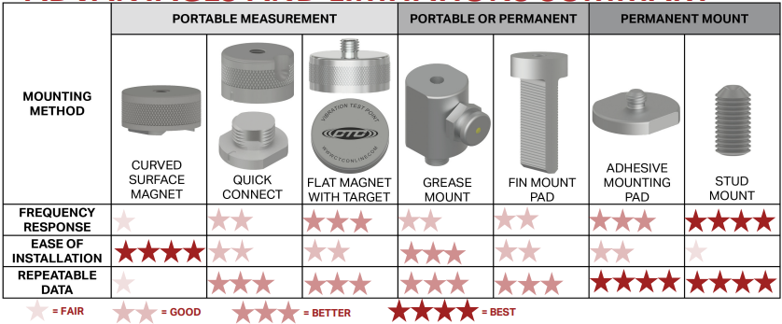
MOUNTING – ADVANTAGES AND LIMITATIONS SUMMARY

Slide 8
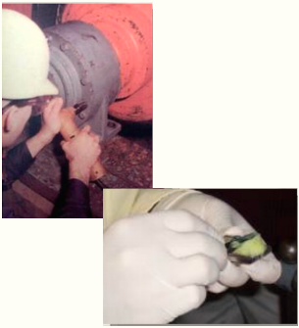
INSTALLATION AND MOUNTING TECHNIQUES
Proper Mounting Techniques
Ensure proper technique for mounting sensors and pads
Proper technique maximizes data quality
Improper technique can lead to unclear or incomplete data and potential sensor damage
Key Objectives for Mounting
Maximize Frequency Response and Data Quality
Maximize stiffness
Limit additional mass
Maximize surface area contact
Place sensors close to the vibration source
Ensure Long-Term Adhesion
Proper surface preparation
Use compatible materials for the environment

Slide 9
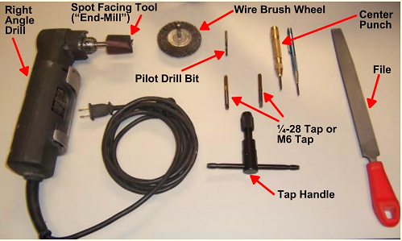
INSTALLATION AND MOUNTING – INSTALLATION TOOLS
Importance of the Right Tools
The right tools are crucial for high-quality installations
Proper tools ensure accuracy and reliability
Let’s take a moment to review the tools you may need:

Slide 10
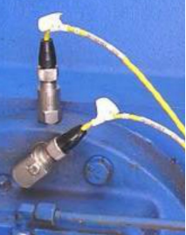
INSTALLATION AND MOUNTING – STUD MOUNTING
Advantages of Stud Mounting Sensors
Enhanced Frequency Transmission
Best transmission of broadest range of frequencies.
Allows use of full sensor frequency range.
Reliability and Resilience
Most reliable and resilient installation method.
Intrinsic Safety Compliance
Meets safety requirements by grounding sensor case in explosive environments.
Requires special sensors and barriers

Slide 11
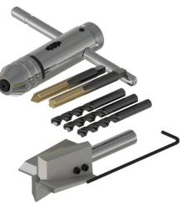
INSTALLATION AND MOUNTING – STUD MOUNTING
Installation and Mounting – Stud Mounting
Preparation
Consult engineering drawings.
Select appropriate end-mill diameter for sensor.
Note pilot hole depth and diameter.
Drilling and Tapping
Use right angle drill with end-mill bit.
Ensure pilot bit depth exceeds exposed stud length.
Ensure flatness (Surface finish: 63 or better, flatness: .001 inches).
Mill and drill pilot hole perpendicular to surface.
Tap hole with appropriate tap sets, starting with "Starter Tap" and finishing with "Bottom Tap."
Final Steps
Clean surface and tighten sensor (2-5 foot-pounds / 2.7-6.8 Nm).
Paint exposed metal to prevent corrosion.

Slide 12
ADHESIVE MOUNTING – EPOXY PADS
Advantages
Ideal for magnet targets ensuring data consistency.
Enhances data transmission over 5 kHz (300,000 CPM).
Suitable for permanent sensor mounting where drilling is not feasible.
Effective for high-frequency data (up to 10 kHz or 600,000 CPM).

Slide 13
ADHESIVE MOUNTING – EPOXY PADS MOUNTING PADS ON MILLED SURFACE
Installation Steps
Mill a flat surface same diameter as the pad using a right angle drill or grinding tool.
Use even pressure; pilot bit set just below the mill to prevent skating.
Clean target and pad surfaces with residue-free solution (e.g., Windex).
Wear clean rubber gloves to avoid contamination.
Apply thin film adhesive (e.g., Loctite 330); ensure compatibility with environment.
Hold pad in place for 30 seconds, tape for 15 minutes to cure.
Paint to prevent corrosion.
Considerations
Avoid use in aggressive environments (e.g., cooling towers).

Slide 14
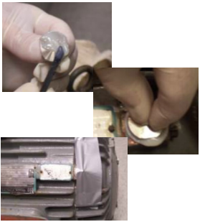
ADHESIVE MOUNTING – MOUNTING PADS ON UN-MILLED SURFACE
Considerations
Loss of higher frequency signals.
Sometimes the only option.
Preparation
Remove paint to expose bare metal using a file or wire wheel.
Clean surfaces of target and pad thoroughly; wear gloves.
Installation Steps
Use gap-filling epoxy (e.g., Devcon Plastic Welder).
Mix epoxy on a clean surface or use an applicator gun.
Ensure epoxy compatibility with environmental factors.
Mounting
Spread thick film of epoxy on the pad.
Press pad onto surface, hold for 30 seconds; do not twist.
Tape pad in place while adhesive sets.
Paint bare metal to prevent corrosion.

Slide 15
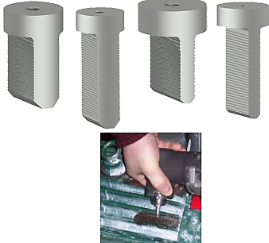
ADHESIVE MOUNTING – INSTALLING MOTOR FIN MOUNTS
To monitor outboard bearings which are covered by an end-bell, analysts should consider using Motor Fin Mounts. They will deliver the vibration signal from the bearings through the housing of the motor, avoiding resonant frequencies which would be encountered if collecting data from the end-bell or top of motor fins:
Scrape fins and valley with end of file and / or wire wheel to bear metal; then clean surface with an acceptable residue-free solution (such as Windex).
Choose the correct size fin mount so that the bottom of the probe will be seated in the valley of the fin, while the pad remains clear of the top of the motor fin.
While wearing disposable gloves, apply a generous amount of epoxy to pad. Be sure to use an epoxy which sets up hard, with good gap filling properties, and fast setting time (such as Devcon Plastic Welder).

Slide 16
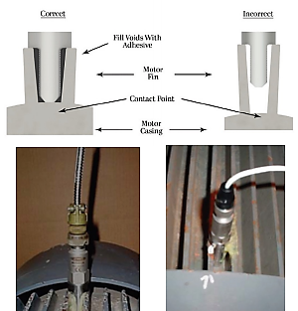
ADHESIVE MOUNTING – INSTALLING MOTOR FIN MOUNTS
Insert the probe portion of the fin mount pad between fins, close to the source of the vibration you are targeting (typically as close to bearing race as possible without touching the end-bell).
Be sure to seat the bottom of the probe in the valley of the motor fin. It is important that the probe base maintains contact with the motor fin valley otherwise you will notice a lack of medium and high frequency data.
Note that the pad section should not touch the top of the fin, otherwise data will include additional resonances from the fins.
Tape the pad in place while epoxy sets

Slide 17
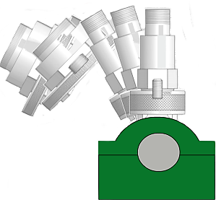
MAGNET MOUNTING – CURVED SURFACE MAGNET MOUNTING
When using a magnet for portable data collection, the proper technique is to rock the magnet onto, and off of, the mounting surface.
Failure to rock the sensor onto the surface can produce very high g levels in the sensor. These high g levels can overload the amplifier in the sensor, causing the sensor to overload or saturate, resulting in data which is commonly referred to as a “ski slope.” Ski sloping causes the low frequency data to register such high amplitudes that no other data is visible on the analyzer.
Gently rocking the sensor onto the mounting surface prevents this sudden shock to the sensor and allows the sensor and analyzer to ”settle” more quickly, so that accurate data can be obtained

Slide 18
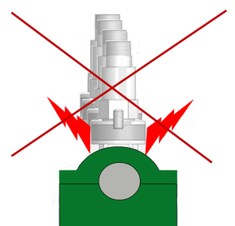
MAGNET MOUNTING – CURVED SURFACE MAGNET MOUNTING
Don’t allow your sensor to be slammed onto the mounting surface.
The resulting ski slope or overload condition which may be caused by the shock to the sensor will yield erroneous data, and will prolong your route collection time.
Repeated shock to the sensor could also permanently damage your sensor. Remember that your sensor and data collector are precision tools which must be handled with care to ensure that your data is consistently accurate

Slide 19
Thank you!
If you have any questions?
Contact us at:
sales@GTI. Xyz
+92-XXXXXXXXX

