Slide 1
FREQUENCY RESPONSE AND MOUNTED RESONANCE FOR ACCELEROMATERS: A BASIC UNDERSTANDING
Level 2: Lesson 2

Slide 2
Objective
Understanding Vibration Analysis Concepts
Natural Frequency: Oscillation frequency of a system, crucial for identifying potential issues.
Frequency Response: System's output to input signal spectrum, essential for design.
Resonance: Large oscillations at natural frequency, critical for preventing damage.
Mounted Resonance: Affects vibration measurement accuracy, ensures proper equipment installation.
Impact: Enhances data accuracy, improves decision-making, and diagnostics in condition monitoring.

Slide 3
Frequency Response- Terms
Natural Frequency:
Frequency at which an object/system vibrates when disturbed.
Depends on stiffness and mass.
Resonance:
Amplified vibration when excited at natural frequency.
Sensor Resonant Frequency:
Listed on sensor datasheets.
Affects sensor’s frequency response.
Frequency Response:
Sensor’s ability to measure accurate vibration amplitudes.
Listed as minimum/maximum frequencies on datasheets.

Slide 4
FREQUENCY RESPONSE – MASS AND STIFFNES
Natural Frequency (Fn):
Defined by stiffness (k) and mass (m).
Formula: Fn=1/2πkm
Mass (m):
m=W/g (weight divided by gravity).
Relationships:
Stiffness (k):
Increases → Natural frequency increases.
Mass (m):
Increases → Natural frequency decreases.
Key Points:
Stiffness ↑ → Fn ↑.
Mass ↑ → Fn ↓.

Slide 5
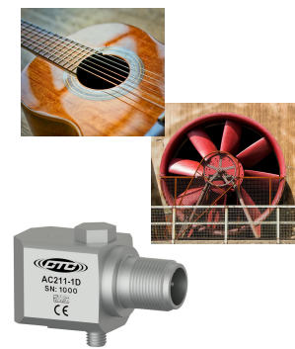
FREQUENCY RESPONSE – EXAMPLE OF STIFFNESS AND NATURAL FREQUENCY
Example 1: Guitar String
Plucked string resonates at natural frequency.
Tightening (increasing stiffness) raises natural frequency → higher pitch.
Example 2: Fan Mounted to Frame
Fan at frame's natural frequency → resonance.
Adding structural support increases stiffness, raises natural frequency above running speed to avoid resonance.
Accelerometer Design:
Maximizes stiffness, minimizes mass to achieve desired resonant frequency and range.

Slide 6
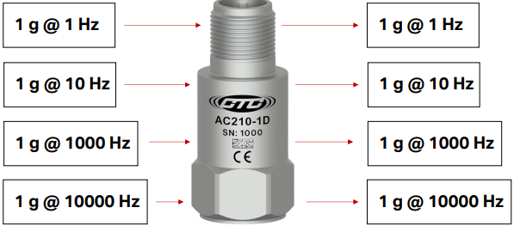
FREQUENCY RESPONSE – WHAT IS IT?
Definition:
Sensor's ability to measure the correct vibration amplitude at any frequency.
Key Concept:
1 g input at 1 Hz → 1 g output at 1 Hz.
1 g input at 1000 Hz → 1 g output at 1000 Hz.

Slide 7
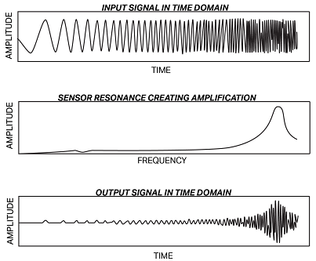
Frequency Response – In the Real World
Non-Flat Response:
Real-world sensors don't have a flat frequency response.
Example:
Upper Plot: Equal amplitude input signal, increasing frequency.
Center Plot: Sensor resonance causes amplification.
Bottom Plot: Output signal shows modified amplitude due to resonance.
Key Point:
Sensor limitations can alter output signal in the time domain.

Slide 8
FREQUENCY RESPONSE – LOW FREQUENCY

Slide 9
FREQUENCY RESPONSE – HIGH FREQUENCY

Slide 10
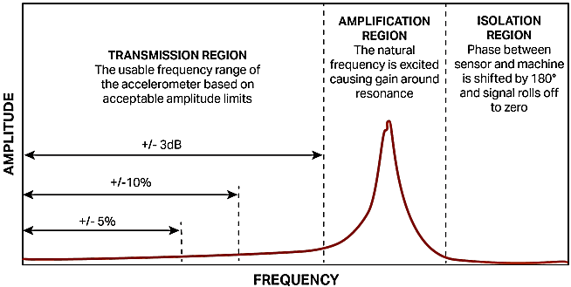
MOUNTED RESONANCE
Definition:
Change in natural frequency due to mounting method.
Affects mass and stiffness.
Effects at Resonance:
Large amplitude gains
Signal amplitude errors
Phase change (~180°)
Potentially destructive forces
Accelerometer Response Regions:
Transmission: Usable region, specified at ±5%, ±10%, or ±3dB.
Amplification: Resonance area, significant signal gain, use with caution.
Isolation: Above resonance, unpredictable gain/phase/amplitude, avoid for measurements.

Slide 11
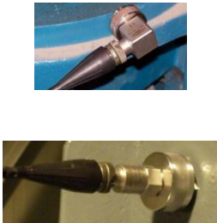
Mounted Resonance – Resonance Changes and Mounting
Impact of Mounting Method:
Affects mounted resonance.
Influences sensor's transmission, amplification, and isolation range.
Alters sensor's frequency response.
Considerations for Analysts:
Non-standard mounts (e.g., other than stud mount) can change resonance and frequency range.
Evaluate impact on collected data.

Slide 12
Mounted Resonance – Typical Mounting Methods
Impact on Frequency Response:
Each mounting method affects the accelerometer's frequency response.
Common Mounting Methods:

Slide 13
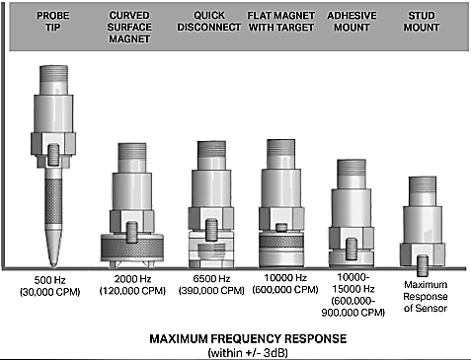
Mounted Resonance – Typical Changes in Response
Impact on Frequency Response:
Different mounting methods affect accelerometer's frequency response within ±3dB limits.
Considerations:
Mounting method choice crucial for sensor performance.
Avoid missing valuable data due to limited frequency response.

Slide 14
Mounted Resonance – Typical Changes in Response
Probe Tip Method
Least surface area contact and consistent pressure.
Low stiffness, adds mass → reduced high frequency response (≤ 500 Hz / 30,000 CPM).
Consider alternative mounts for critical data above 500 Hz.
Curved Surface Magnet
Increases stiffness with more contact area and magnetic pull.
Adds significant mass, higher mounted resonance.
Better high frequency response (≤ 2000 Hz / 120,000 CPM).

Slide 15
Mounted Resonance – Typical Changes in Response
Quick Disconnect Systems
Designed for speed and consistent data collection.
Variable stiffness, some enhance high frequency response.
Example: CTC’s system offers up to 6500 Hz (390,000 CPM) transmission range.
Flat Magnet with Target
Maximizes surface area contact and stiffness.
Higher mass compared to stud mount.
Good data up to 7000-8000 Hz (420,000-480,000 CPM); some report up to 10,000 Hz (600,000 CPM).

Slide 16
Summary
Consider accelerometer specifications for frequency response when selecting your accelerometer:
1
Frequencies above the operating specifications will have increased amplitudes
2
Frequencies below the operating specifications will have decreased amplitudes
3
Natural frequency will depend on the mass and stiffness of the accelerometer and mounting
4
Resonance occurs when the frequency of vibration is the same as the natural frequency of the accelerometer
5
Mounted resonance is a result of the mounting method used, and can have a direct effect on the natural frequency
6
Choose the accelerometer and mounting method YOU need to measure YOUR machine frequencies and avoid resonance
7
Work within the ”transmission” range of the frequency response.
8

