Slide 1
THE RIGHT TOOL FOR THE JOB: SELECTING THE PROPER ACCELEROMETER FOR YOUR APPLICATION
LEVEL 2 – LESSON 4

Slide 2
OBJECTIVES
After completing this training module you will understand:
1) The general construction of an accelerometer
2) How those differences in construction make a specific sensor more suited to measuring specific types of applications
3) How using the right tools will help analysts gather better, clearer data from which to make very important decisions about machinery health

Slide 3
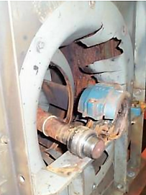
PREVENTIVE FAILURES
Root Cause: Lack of lubrication led to catastrophic bearing failure.
Solution:
Vibration Monitoring Program:
Use of an accelerometer to measure vibration.
Early detection of lubrication issues.
Benefits:
Early detection allows for preventive steps.
Condition monitoring programs utilizing vibration analysis are highly valuable.
Prevents sudden unexpected failures.

Slide 4
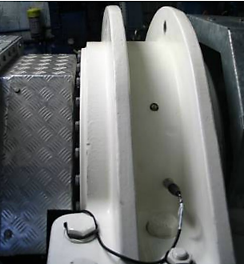
Measuring Machinery Vibration
Prevention:Using an accelerometer prevents unexpected machine failures.
Vibration Measurement:
Portable or permanent measurements can be trended over time.
Increased vibration levels trigger detailed analysis and scheduled repairs.
Choosing the Right Accelerometer:
Provides the best measurements and detailed information.
Not all accelerometers fit all applications.
Understanding their operation and application is crucial for success.

Slide 5
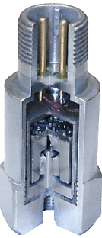
Parts of an IEPE Sensor (Integrated Electronics Piezo Electric)
Accelerometers are widely used to measure vibration in rotating machinery due to:
Broad frequency and dynamic range
Durability and portability inherent in their design
For this training, we will focus on:
Industrial accelerometers with common construction and material:
Annular shear mode design utilizing PZT ceramic
Provides a low noise solution
High durability and stability in various environments

Slide 6
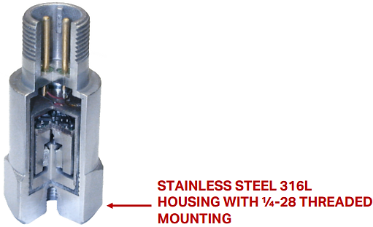
PARTS OF AN IEPE SENSOR - (INTEGRATED ELECTRONICS PIEZO ELECTRIC)
The external housing of the sensor should be made from a material like 316L.
This corrosive-resistant stainless steel is well suited for industrial environments

Slide 7
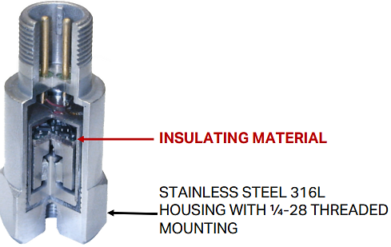
PARTS OF AN IEPE SENSOR - (INTEGRATED ELECTRONICS PIEZO ELECTRIC)
The application of a rigid insulating material between the sensing element and sensor housing will provide case isolation while still providing good transmission of the vibration to the sensing element.
Case isolation is important in the industrial environment due to a variety of grounding and interference issues which could be present. Lack of isolation will lead to data with transient spikes which are unrelated to vibration

Slide 8
PARTS OF AN IEPE SENSOR - (INTEGRATED ELECTRONICS PIEZO ELECTRIC)
The pedestal (or post) is attached to the base and holds the PZT ceramic in place. Vibration is transmitted through the base of the sensor to the post.

Slide 9
PARTS OF AN IEPE SENSOR - (INTEGRATED ELECTRONICS PIEZO ELECTRIC)
The PZT ceramic acts as the internal stiffness factor in the sensor. When a force acts on the PZT material, an electrical charge is produced proportional to the forces.
The PZT (piezoelectrical lead zirconate titanate) ceramic is a very high quality material with excellent mechanical strength and temperature stability. PZT has extremely low noise characteristics and provides a high signal to noise ratio

Slide 10
PARTS OF AN IEPE SENSOR - (INTEGRATED ELECTRONICS PIEZO ELECTRIC)
A mass is placed on the outside of the PZT ceramic and acts as the internal mass for the sensor.
A high quality (non ferrous) stainless steel mass should be used to prevent magnetic interference and false vibrations.

Slide 11
PARTS OF AN IEPE SENSOR - (INTEGRATED ELECTRONICS PIEZO ELECTRIC)
The electronics on the PC Board are used to convert the charge output of the PZT ceramic to a voltage, apply filtering, and amplify the output of the sensor.

Slide 12
PARTS OF AN IEPE SENSOR - (INTEGRATED ELECTRONICS PIEZO ELECTRIC)
The faraday shield protects the sensor electronics from RFI (radio frequency interference) and EMI (electro magnetic interference).

Slide 13
PARTS OF AN IEPE SENSOR - (INTEGRATED ELECTRONICS PIEZO ELECTRIC)
The MIL C 5015 connector is the standard connector used in industrial vibration analysis.

Slide 14
PARTS OF AN IEPE SENSOR - (INTEGRATED ELECTRONICS PIEZO ELECTRIC)
A welded seam between the connector and the sensor provides a hermetic seal.
The hermetic seal prevents any contamination from entering the sensor.

Slide 15
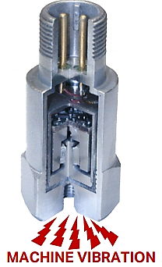
Shear Mode Functionality
Sensor Mounting:When mounted, machine vibration enters through the sensor base, making it vibrate.
Newton’s First Law of Motion:“An object at rest tends to stay at rest.”
Sensor Mechanics:
Internal Mass: Located outside the PZT ceramic, tends to stay at rest.
Pedestal/Post: Inside the PZT ceramic, vibrates at the same rate as the machine.
Shear Stress on PZT Ceramic:PZT ceramic is in shear between the vibrating post and stationary mass.
This stress creates a charge output proportional to vibratory forces.
The charge is filtered, amplified, and sent to the analysts' systems.

Slide 16
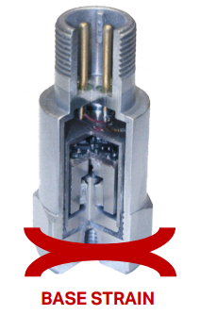
SHEAR MODE BENEFITS
Primary Benefit: Resistance to Base Strain
Why?
PZT ceramic is not used in compression mode
Allows base strain without affecting sensor output
Causes of Base Strain:
Temperature transients
Lateral forces on the sensor (e.g., data collector cables)
Impact:
Preventing base strain enhances measurement accuracy
Additional Benefit: Minimal Output Changes from Gravity
How?
Unidirectional sensor mounting
Little to no effect from earth's gravitational force

Slide 17
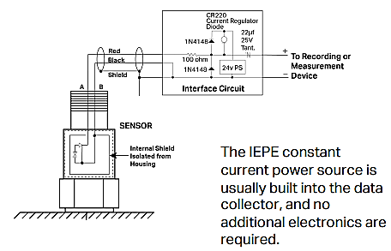
Bias Voltage for IEPE Accelerometers
IEPE Accelerometer Overview
Type: Two-wire sensor
Power Source Requirements:
Constant current: 2-10 mA
DC voltage: 18-30 VDC
Bias Voltage
Definition: DC operating voltage of the internal electronics
Typical Range: 7-14 VDC
Vibration Signal
Nature: AC signal superimposed on DC bias voltage
Separation:
De-coupling capacitor used
Separates AC signal (vibration) from DC bias voltage

Slide 18
SENSITIVITY, RANGE AND APPLICATION

Slide 19
SENSITIVITY, RANGE AND APPLICATION

Slide 20
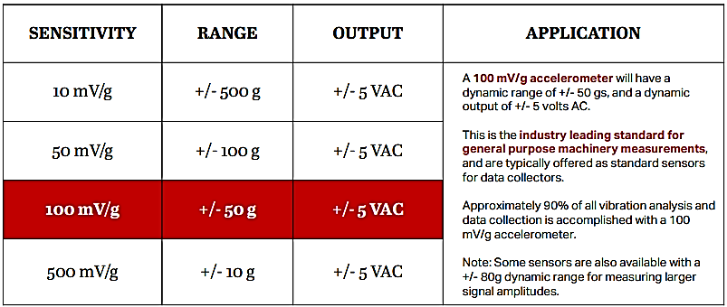
SENSITIVITY, RANGE AND APPLICATION

Slide 21
SENSITIVITY, RANGE AND APPLICATION

Slide 22
SPECIALTY ACCELEROMETER
High Temperature Sensors Categories:
IEPE (Internally Amplified) Sensors:
Suitable for applications up to 150°C (302°F)
Charge Output (Externally Amplified) Sensors:
Used for higher temperature applications such as turbines, boiler feed pumps, and some compressors
Key Points:
IEPE Sensors Limitation:
Not suited for temperatures above 150°C (302°F) due to amplifier board limitations
Charge Output Sensors Advantage:
Amplifier can be moved to cooler temperatures for high-temperature applications

Slide 23
SPECIALTY ACCELEROMETER
Piezo Velocity Sensors:
Utilize analog integration
Suitable for applications where velocimeters are traditionally used for casing measurements
Helpful in identifying fundamental fault frequencies
Intrinsically Safe Sensors:
Required for vibration measurements in hazardous areas (gas, oil, mining, dust, etc.)
Triaxial Sensors:
Measure vibration in three axes (x, y, z) simultaneously with one accelerometer
Speed data collection and reduce installation time
Provide more complete data in areas with limited mounting options

Slide 24
SPECIALTY ACCELEROMETER
Dual Output Sensors:
Measure dynamic vibration and temperature simultaneously
Provide valuable data for assessing machine condition
4-20 mA Loop Power Sensors:
Provide current output proportional to overall acceleration or velocity value
Signal can trigger alarms and provide constant monitoring
Dual Output Loop Power Sensors:
Provide 4-20 mA output proportional to vibration in acceleration
Include °C temperature output

Slide 25
INDUSTRIAL REQUIREMENTS AND USE
The top three requirements for an industrial sensor are:
Functionality
Durability
Affordability
Primary industrial uses are:
Trending vibration levels
Alarming high vibration amplitudes
Diagnosing machinery faults
Always choose the sensor that best fits your application. One sensor does not fit all applications, and several output sensitivities are available along with a wide range of specialty sensors. Always choose the sensor you need for your specific application.

Slide 26
Prevent Failures with Accelerometers
Case Study: Bearing Failure Due to Electrical Current
Problem:
Current passing through the bearing caused fluting in the races.
Resulted in rapid deterioration of the bearing.
Overheating eventually destroyed the bearing and the motor.
Solution:
Vibration measurements with an accelerometer could have provided early detection.
Early analysis would have triggered further investigation and correction.
Prevent catastrophic failure by addressing root causes in time.
Key Takeaway:
Don’t let this happen to your machines!
Utilize accelerometers for early problem detection and prevention.

Slide 27
Thank you!
If you have any questions ?
Contact us :
sales@GTI.xyz
+92-xxxxxxx

