Slide 1
Integrated Ultrasound Training-Detecting Leaks, Testing Valves & Steam Traps And Analyzing Bearings And Electrical Systems

Slide 2
Course Contents:
Overview
Introduction to Condition Monitoring
Introduction to Sound Theory
Propagation of Sound
Introduction to Ultrasound Testing
Airborne Leaks and Leaks Detection
Steam Systems and Steam Trap Testing
Electrical Systems and Testing
Bearings and Bearing Fault Detection
Bearing Lubrication
Mechanical Inspection
Tightness and Integrity
Reporting

Slide 3
Section 1: Overview

Slide 4
Overview
Applications:
Predictive and Preventive Maintenance
Energy Management
Quality Control
Relevant Standards
ISO 18436-8:2013
Personal Qualification and Certification in Non-Destructive Testing
ISO 1436-3:2012
Condition Monitoring and Diagnostics

Slide 5
Overview- CONTD
Applications
Airborne Leaks
Steam and Steam Traps
Valves
Hydraulics
Tightness Testing
Lubrication
Mechanical Systems
Electrical Systems (high, medium and low voltage)

Slide 6
Overview- CONTD
ISO 18436-8:
Standard Overview: Defines requirements for training, certification, and assessment of personnel in ultrasound inspection.
Scope: Focuses on condition monitoring and diagnostics of machines using ultrasound technology.
Competency Levels:
Category I: Basic understanding, data collection.
Category II: Advanced data analysis, fault diagnosis.
Category III: Expert-level analysis, program management
Training Requirements: Specifies hours of training, hands-on practice, and examination for certification.
Certification Validity: Certification is valid for five years, requiring recertification.
Global Recognition: Ensures consistent competency standards worldwide in ultrasound inspection.

Slide 7
Overview
Market Sectors
Automotive and transportation
Food Processing
Water treatment
Marine
Textiles
Oil and Gas
Chemical and Petrol Chemical
Pulp and paper
Rubber and tire
Power Generation and distribution
Aviation and space

Slide 8
Section 2: Introduction to CM (Condition Monitoring)

Slide 9
Introduction to CM
“Continuous or periodic monitoring of equipment health to detect changes or anomalies, enabling early identification of potential failures to optimize maintenance and reduce downtime.”
Purpose:
Identify potential failures before they lead to breakdowns.
Optimize maintenance schedules.
Reduce downtime and maintenance costs.

Slide 10
Introduction to CM- CONTD.
Failures
Age related: Early-life failures of equipment, often due to manufacturing defects or initial operational stresses.
Age-related: Failures that occur as equipment ages, typically due to wear and tear or material degradation.
Random: Unpredictable failures that can occur at any time during equipment's life, often due to unforeseen external factors or random defects.

Slide 11
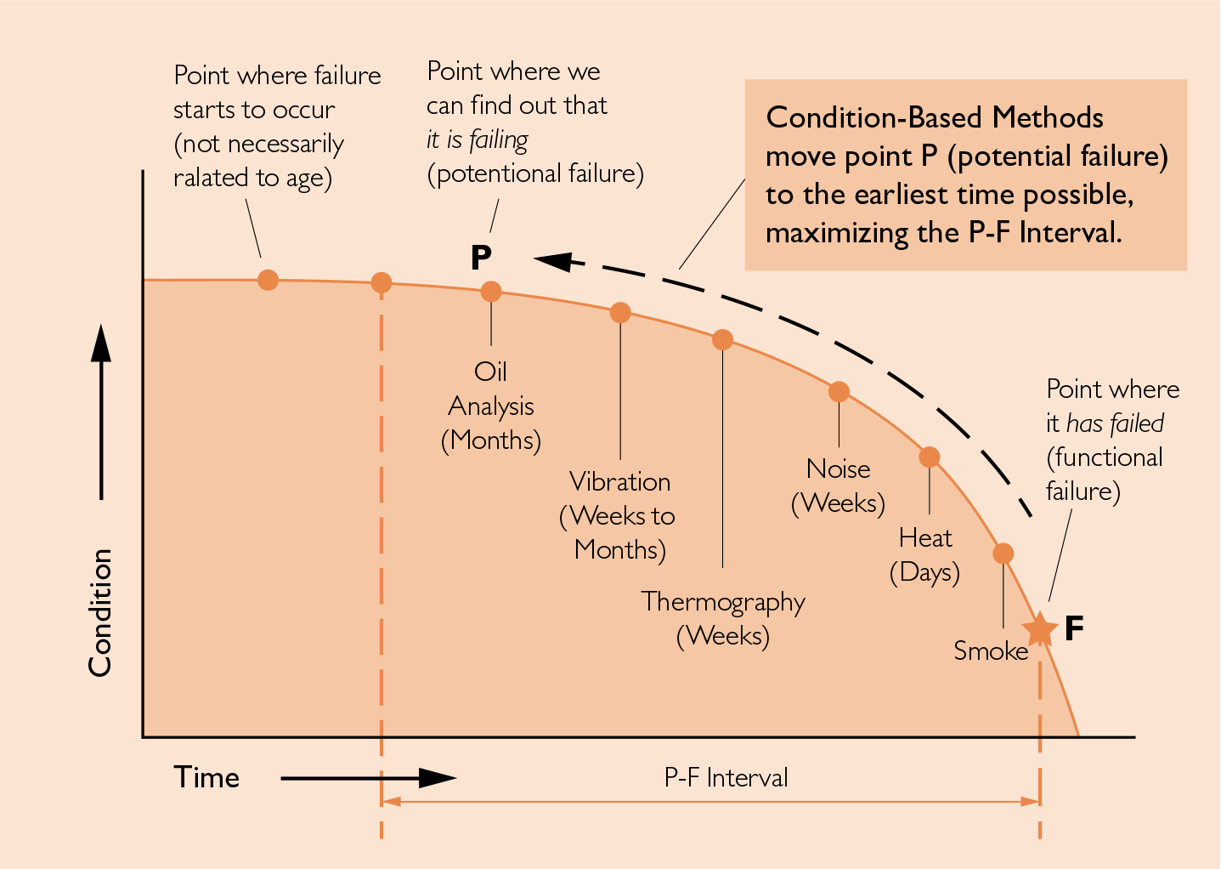
Introduction to CM- CONTD.
P-F INTERVAL
The time period between the detection of a potential failure (P) and the occurrence of functional failure (F).
Provides a window for proactive maintenance to prevent failure.
Potential Failure (P): The point where a condition can be detected, indicating that a failure is developing.
Functional Failure (F): The point where the equipment can no longer perform its intended function.

Slide 12
Introduction to CM
Condition Monitoring Technologies
Vibration Analysis
Oil/Wear Debris Analysis
Infrared Thermography
Ultrasound Analysis
Non Destructive Testing
Current Signature Analysis
Current Signature Analysis
Maintenance And Reliability
Run to Failure, Reactive or “breakdown” maintenance
Time Based Preventive Maintenance
Condition monitoring or Predictive Maintenance
Precision Proactive Maintenance

Slide 13
Section 3: Introduction to Sound Theory

Slide 14
Introduction to Sound Theory
What is Ultrasound?
Ultrasound is a type of sound wave with frequencies higher than the upper audible limit of human hearing, typically above 20 kHz. It is commonly used in medical imaging, industrial non-destructive testing, and various other applications to detect internal features or diagnose conditions by analyzing how these high-frequency sound waves interact with materials or tissues.

Slide 15
Introduction to Sound Theory- CONTD
Sound Wave Motion
Definition: Sound waves are mechanical waves that result from the vibration of particles in a medium, such as air, water, or solids.
Types: Sound waves are typically longitudinal waves, where particles vibrate parallel to the direction of the wave's travel.
Propagation:
The wave causes alternating regions of compression (high pressure) and rarefaction (low pressure) as it travels through a medium.
Speed of sound depends on the medium's properties like density and elasticity (faster in solids, slower in gases).
At low frequency sound is omnidirectional & at high frequency it becomes directional.

Slide 16
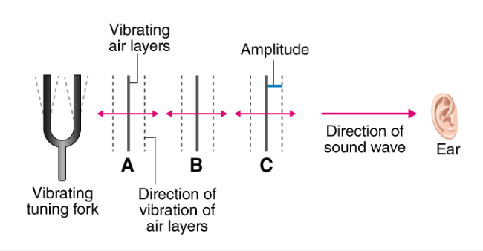
Introduction to Sound Theory- CONTD
How Sound is Produced
Vibrations: Sound is produced when an object vibrates, creating disturbances in the surrounding medium (air, water, etc.).
Source of Vibration: Examples include vocal cords, musical instruments, or machinery. These vibrations create alternating regions of compression and rarefaction in the medium.
Transmission:
The vibrations cause particles in the medium to oscillate, transferring energy as a sound wave.
Longitudinal Waves: Particles vibrate parallel to the direction of the wave's motion.
Medium: A medium (air, water, or solids) is necessary for sound to travel, as it cannot propagate in a vacuum.
Perception: The ear detects these vibrations, translating them into the sound we hear.

Slide 17
Introduction to Sound Theory- CONTD

Slide 18
Introduction to Sound Theory- CONTD
Sine Wave: A sine wave is a smooth, periodic oscillation that represents a pure sound tone. It’s characterized by a continuous wave with a uniform frequency and amplitude, and is the most basic form of a sound wave.
Eight Fundamental Properties of Sound Waves:
Frequency (Hz): Number of cycles per second, determining the pitch of the sound.
Amplitude: The height of the wave, corresponding to the loudness; measured in decibels (dB).
Wavelength (λ): Distance between consecutive compressions or rarefactions.
Compression: Region of high pressure where particles are close together.
Rarefaction: Region of low pressure where particles are spread apart.
Decibels (dB): A unit for measuring sound intensity or loudness.
Loudness: Perceived volume of sound, related to amplitude, measured in decibels.
Pitch: How high or low a sound is, determined by its frequency (higher frequency = higher pitch).

Slide 19
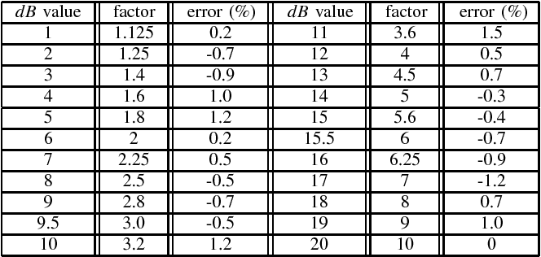
Introduction to Sound Theory
.

Slide 20
Section 4: Propagation of Sound

Slide 21
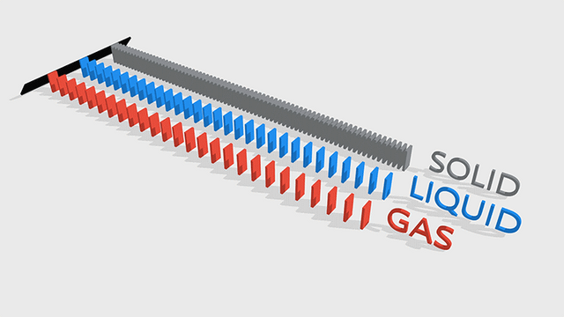
Propagation of Sound
.
Sound Velocity
Definition: Sound velocity is the speed at which sound waves travel through a medium. It depends on the medium’s density and elasticity.
Dependence:
Higher density (e.g., solids) allows sound to travel faster.
Temperature and pressure also affect sound velocity; higher temperatures typically increase speed in gases.

Slide 22
Propagation of Sound-CONTD
Relation Between Velocity, Wavelength, and Frequency
Formula: v= f × λ
The velocity of sound is the product of its frequency and wavelength. As frequency increases, wavelength decreases, and vice versa, assuming a constant velocity.

Slide 23
Propagation of Sound-CONTD
Sound Amplitude vs Distance: Inverse Distance Law
Inverse Distance Law: The amplitude of a sound decreases as the distance from the source increases, following an inverse-square relationship.
Formula: A ∝ 1/d^2
A: Amplitude of the sound
d: Distance from the sound source
Explanation: As you move further from the sound source, the sound's amplitude decreases proportionally to the square of the distance. This results in a noticeable reduction in loudness with increased distance.
If you are going to carry out an air leak loss assessment or trend a bearing noise, you must perform the test at the same distance every time.
All ultrasound levels should be accompanied by a distance (40 dBmicroV @1m)

Slide 24
Propagation of Sound-CONTD
Reflection in Ultrasonic Inspection
Definition: In ultrasonic inspection, reflection occurs when high-frequency sound waves (ultrasound) encounter boundaries or discontinuities within a material, causing a portion of the waves to bounce back to the transducer.
Key Concepts:
Echoes: Reflected sound waves (echoes) provide information about the internal structure and defects of the material.
Impedance Mismatch: Reflection is influenced by the acoustic impedance difference between materials or internal features.
Time of Flight: The time it takes for the echoes to return helps determine the depth and location of internal features or defects.
Applications: Reflection in ultrasonic inspection is crucial for detecting flaws, measuring thickness, and assessing material integrity in industrial testing and quality control.

Slide 25
Propagation of Sound-CONTD
Reflection can be your friend. You may detect the presence of ultrasound because of it.

Slide 26
Propagation of Sound
Barriers:
Ultrasound can be blocked by a surface. The golden rule; a barrier must be at least ¼ wavelength in all dimensions to be significant.
Transmission:
When a sound wave travelling through a medium (air, gas, etc.) reaches a boundary with another medium, some proportion of the sound wave is reflected and the rest is transmitted.
The amount of reflection is governed by the Specific Acoustic Impedence of the two materials.
$R= \frac{Z1−Z2}{z1+z2}$
T= 1 - R

Slide 27
Section 5: Introduction to Ultrasonic Testing

Slide 28
Introduction to Ultrasonic Testing -CONTD
Why Ultrasound Inspection?
Non-Destructive Testing (NDT): Allows for the examination of materials and structures without causing damage, ensuring integrity and safety.
High Sensitivity: Capable of detecting small defects and internal flaws that are not visible on the surface, providing detailed insights into material conditions.
Versatility: Effective for a wide range of materials (metals, composites, ceramics) and applications (thickness measurement, flaw detection, bonding assessment).
Specific Knowledge
Acoustic Impedance: Understanding how different materials' acoustic impedance affects wave reflection and transmission is crucial for accurate inspections.
Wave Propagation: Knowledge of how ultrasonic waves travel through different media and interact with defects helps in interpreting inspection results.
Transducer Selection: Selecting the appropriate transducer frequency and type based on the material and inspection requirements is essential for optimal performance.

Slide 29
Introduction to Ultrasonic Testing -CONTD
Heterodyning
Definition: Heterodyning is a signal processing technique where two signals (usually of different frequencies) are mixed to produce new frequencies, typically the sum and difference of the original frequencies.
Process:
Mixing: Combining two input frequencies using a non-linear mixer or detector.
Output Frequencies: Results in two new frequencies: fout1=fsignal1+fsignal2 and fout2=fsignal1−fsignal2
Applications:
Communication Systems: Used in radio and television receivers to convert high-frequency signals to lower, more manageable intermediate frequencies (IF).
Signal Processing: Facilitates easier analysis and amplification of signals by shifting their frequency range.

Slide 30
Introduction to Ultrasonic Testing -CONTD
Different Ultrasonic Devices
Ultrasonic Transducers:
Piezoelectric Transducers: Convert electrical signals into ultrasonic waves and vice versa; commonly used for generating and receiving ultrasound.
Electrostatic Transducers: Utilize electrostatic fields to produce ultrasonic waves; used in specialized applications.
Ultrasonic Thickness Gauges:
Contact Gauges: Measure material thickness by sending ultrasonic waves through the material and detecting echoes.
Non-Contact Gauges: Use air-coupled or laser-based methods to measure thickness without direct contact.
Ultrasonic Flaw Detectors:
Portable Detectors: Handheld devices used for field inspections to detect and characterize internal defects in materials.
Automatic Systems: Advanced systems used in manufacturing for real-time defect detection and quality control.

Slide 31
Introduction to Ultrasonic Testing -CONTD
Clipping:
Clipping occurs when the amplitude of a signal exceeds the range of the system's recording or output capability, causing the peaks to be "cut off." This leads to distortion in the signal, which can mask important details during ultrasound testing.
Autoranging:
Autoranging is a feature in measurement devices that automatically adjusts the range of the instrument to capture the signal with optimal resolution. It ensures that the recorded signal stays within the measurable limits, enhancing accuracy during testing.
Peak Value: The highest value attained by a signal, crucial in ultrasound testing to identify signal extremes.
Crest Factor: The ratio of the peak value to the root mean square (RMS) value of a signal. A high crest factor indicates sharp peaks, which are important in identifying transient events in ultrasound testing.

Slide 32
Introduction to Ultrasonic Testing
Kurtosis in Dynamic Signals:
Kurtosis is a statistical measure that indicates the presence of sharp peaks or outliers in a signal. In dynamic signals during ultrasound testing, high kurtosis values may reveal defects or anomalies in the material being inspected.
Frequency Analysis:
Frequency analysis breaks down a signal into its component frequencies to identify patterns or anomalies. In ultrasound testing, this helps to detect material properties, flaws, or inconsistencies by analyzing how different frequencies interact with the material being tested.

Slide 33
Section 6: Airborne Leaks and Leaks Detection

Slide 34
Airborne Leaks & Leaks Detection-CONTD
Introduction to Airborne Leaks
What are Airborne Leaks? Airborne leaks refer to unintended escapes of gases or fluids from pressurized systems into the atmosphere, often through small cracks or faulty seals.
Importance of Detecting Airborne Leaks Detecting leaks is essential for maintaining system efficiency, ensuring safety, and minimizing environmental impact, especially in industrial settings like oil & gas or HVAC systems.
Common Sources of Airborne Leaks
Valves
Compressed air systems
Gaskets and seals
Pipelines

Slide 35
Airborne Leaks & Leaks Detection-CONTD
How Ultrasound Testing Detects Leaks Leaks generate high-frequency sound waves that are inaudible to the human ear. Ultrasound detectors
convert these signals into audible sound, allowing precise location of the leak.
Advantages of Ultrasound Leak Detection
Pinpoints exact leak location
Works even in noisy environments
Cost-effective and non-invasive
Suitable for both high- and low-pressure systems
Basic Procedure
Survey the area with an ultrasound detector.
Listen for the characteristic hiss or whistle of escaping air or gas.
Confirm the leak location by narrowing down the strongest signal.

Slide 36
Airborne Leaks & Leaks Detection
Applications & Benefits
Key Applications
Compressed air systems
Refrigeration systems
Vacuum systems
Gas pipelines
Benefits of Early Leak Detection
Energy Savings: Identifying and fixing leaks reduces energy losses.
Enhanced Safety: Prevents hazardous gas leaks, reducing the risk of explosions or environmental damage.
Reduced Maintenance Costs: Early detection helps avoid costly breakdowns and equipment damage.

Slide 37
Section 7: Steam Traps and Steam Trap Systems

Slide 38
Steam Traps and Steam Trap Systems -CONTD
Introduction to Steam Systems and Steam Traps
What is a Steam System? Steam systems are used to transfer heat energy in industrial processes. Steam is generated in boilers and distributed through pipelines to various equipment.
Role of Steam Traps Steam traps are mechanical devices designed to remove condensate (water) and air from steam lines while retaining live steam. Proper functioning of steam traps ensures energy efficiency and prevents system damage.
Common Issues in Steam Systems
Condensate buildup
Steam leaks
Inefficient traps, leading to energy loss

Slide 39
Steam Traps and Steam Trap Systems -CONTD
Ultrasound Testing for Steam Trap Detection
How Ultrasound Detects Steam Trap Issues Ultrasound testing detects high-frequency sounds generated by the movement of steam, condensate, or air through steam traps. Anomalies in these sounds indicate steam trap malfunctions such as leaks or blockages.
Typical Steam Trap Problems
Blowthrough: Continuous flow of steam due to a failed trap.
Blocked Trap: No discharge of condensate, causing system inefficiencies.
Leaking Trap: Partial discharge of live steam along with condensate.
Procedure for Testing Steam Traps
Survey the steam trap with an ultrasound detector.
Listen for the unique sound patterns of a functioning trap.
Identify any deviations indicating malfunction.

Slide 40
Steam Traps and Steam Trap Systems
Benefits and Applications of Steam Trap Testing
Key Applications
Power generation plants
Food processing industries
Chemical plants
Refineries
Benefits of Regular Steam Trap Testing
Energy Efficiency: Detecting and fixing faulty steam traps minimizes energy losses.
Reduced Downtime: Early detection of issues prevents larger system failures.
Cost Savings: Prevents expensive steam loss and reduces operational costs.
Environmental Benefits: Reduces emissions from steam losses.

Slide 41
Section 8: Valves and Valves Testing

Slide 42
Valves and Valves Testing - CONTD
Introduction to Valves and Ultrasound Testing
Valves in Industry: Critical components used to regulate, direct, or control the flow of fluids in pipelines.
Common Types: Gate valves, ball valves, butterfly valves, check valves, and globe valves.
Importance of Testing: Valves operate under high pressure and stress, requiring regular testing to ensure safety and functionality.
Ultrasound Testing: A non-destructive method (NDT) to detect flaws, thickness variations, and internal defects in valves.

Slide 43
Valves and Valves Testing - CONTD
Introduction to Valves and Ultrasound Testing
Valves in Industry: Critical components used to regulate, direct, or control the flow of fluids in pipelines.
Common Types: Gate valves, ball valves, butterfly valves, check valves, and globe valves.
Importance of Testing: Valves operate under high pressure and stress, requiring regular testing to ensure safety and functionality.
Ultrasound Testing: A non-destructive method (NDT) to detect flaws, thickness variations, and internal defects in valves.

Slide 44
Valves and Valves Testing
Applications and Benefits of Ultrasound Valve Testing
Applications: Commonly used in oil & gas, chemical processing, power generation, and water treatment industries.
Benefits:
Early Detection of Flaws: Helps prevent catastrophic failures.
Minimally Invasive: No need for valve disassembly.
Cost-Efficient: Reduces downtime and maintenance costs.
Accuracy: Highly sensitive to small defects and can monitor valve integrity over time.

Slide 45
Section 9: Hydraulics and Hydraulic Systems Testing

Slide 46
Hydraulics and Hydraulic Systems Testing - CONTD
Introduction to Hydraulics and Hydraulic Systems
Hydraulic Systems: Use pressurized fluid to power machinery and perform work (e.g., lifting, moving, or pressing).
Key Components: Hydraulic pumps, cylinders, valves, hoses, and actuators.
Importance of Testing: Hydraulic systems are prone to leaks, blockages, and wear, which can lead to inefficiency or failure.
Ultrasound Testing: A non-invasive, non-destructive method (NDT) to detect issues within hydraulic systems such as leaks, cavitation, and pressure drops.

Slide 47
Hydraulics and Hydraulic Systems Testing - CONTD
Ultrasound Testing Techniques for Hydraulic Systems
Principle of Ultrasound Testing: Uses high-frequency sound waves to detect changes in fluid flow, pressure, and system integrity.
Testing Methods:
Airborne Ultrasound: Detects leaks in hoses, seals, and joints by capturing the high-frequency sound of escaping fluid.
Structure-Borne Ultrasound: Identifies internal issues like cavitation or blockages by analyzing the sound waves passing through hydraulic components.
Benefits: Fast, precise, and does not require system shutdown.

Slide 48
Hydraulics and Hydraulic Systems Testing
Applications and Benefits of Ultrasound Testing in Hydraulics
Applications: Used in industries like manufacturing, construction, aerospace, and automotive for testing hydraulic systems in machinery, elevators, cranes, and more.
Benefits:
Leak Detection: Detects small, invisible leaks in pipes, valves, and hoses, preventing fluid loss and system inefficiency.
Cavitation Identification: Helps in spotting cavitation within pumps, preventing damage.
Cost-Effective Maintenance: Reduces downtime by identifying issues early, allowing for predictive maintenance and longer equipment life.

Slide 49
Section 10: Electrical Systems Testing

Slide 50
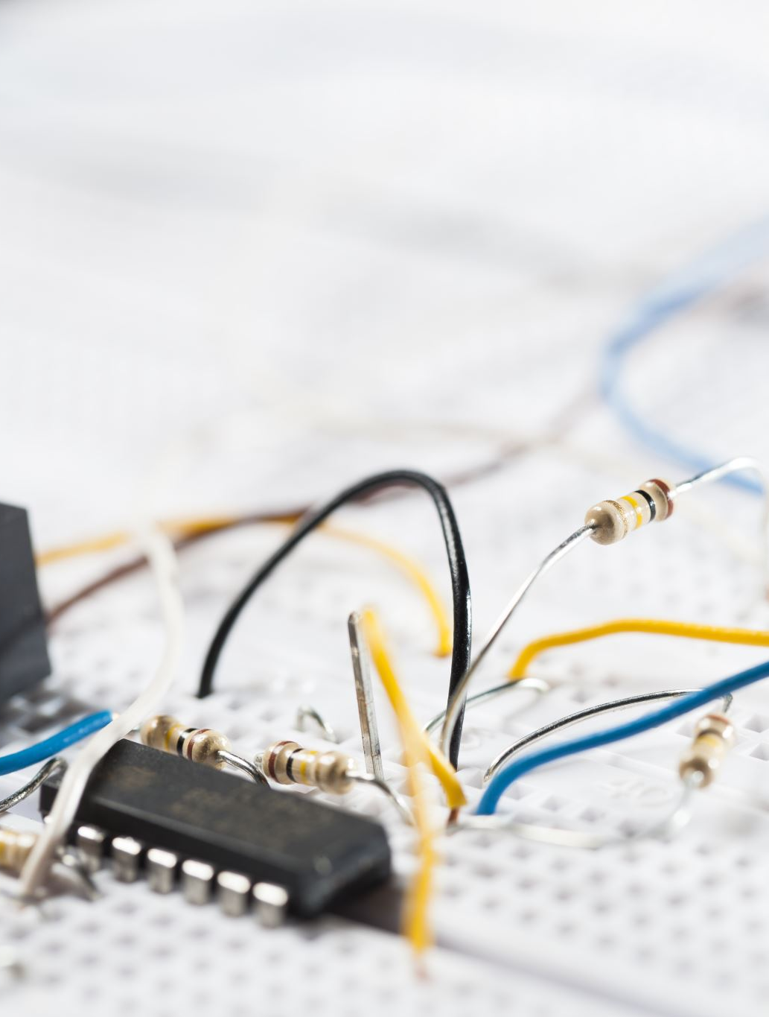
Electrical Systems Testing -CONTD
Introduction to Electrical Systems and Ultrasound Testing
Electrical Systems: Include components such as transformers, switchgear, circuit breakers, and power distribution panels.
Importance of Testing: Electrical systems are prone to failures due to insulation breakdown, arcing, and partial discharge, which can lead to system malfunctions and safety hazards.
Ultrasound Testing: A non-destructive testing (NDT) method that detects high-frequency sounds generated by electrical faults.

Slide 51
Electrical Systems Testing
Ultrasound Testing Techniques for Electrical Systems
Principle of Ultrasound Testing: Ultrasound sensors detect high-frequency sounds that are inaudible to the human ear, which occur during electrical discharges.
Testing Methods:
Airborne Ultrasound: Used to detect arcing, tracking, and corona in high-voltage electrical systems.
Contact Ultrasound: Identifies issues like insulation breakdown or loose electrical connections by placing a sensor on the equipment's surface.
Advantages: Allows for testing while systems are energized, ensuring safety and minimizing downtime.

Slide 52
Section 11: Bearing and Bearing Fault Detection

Slide 53
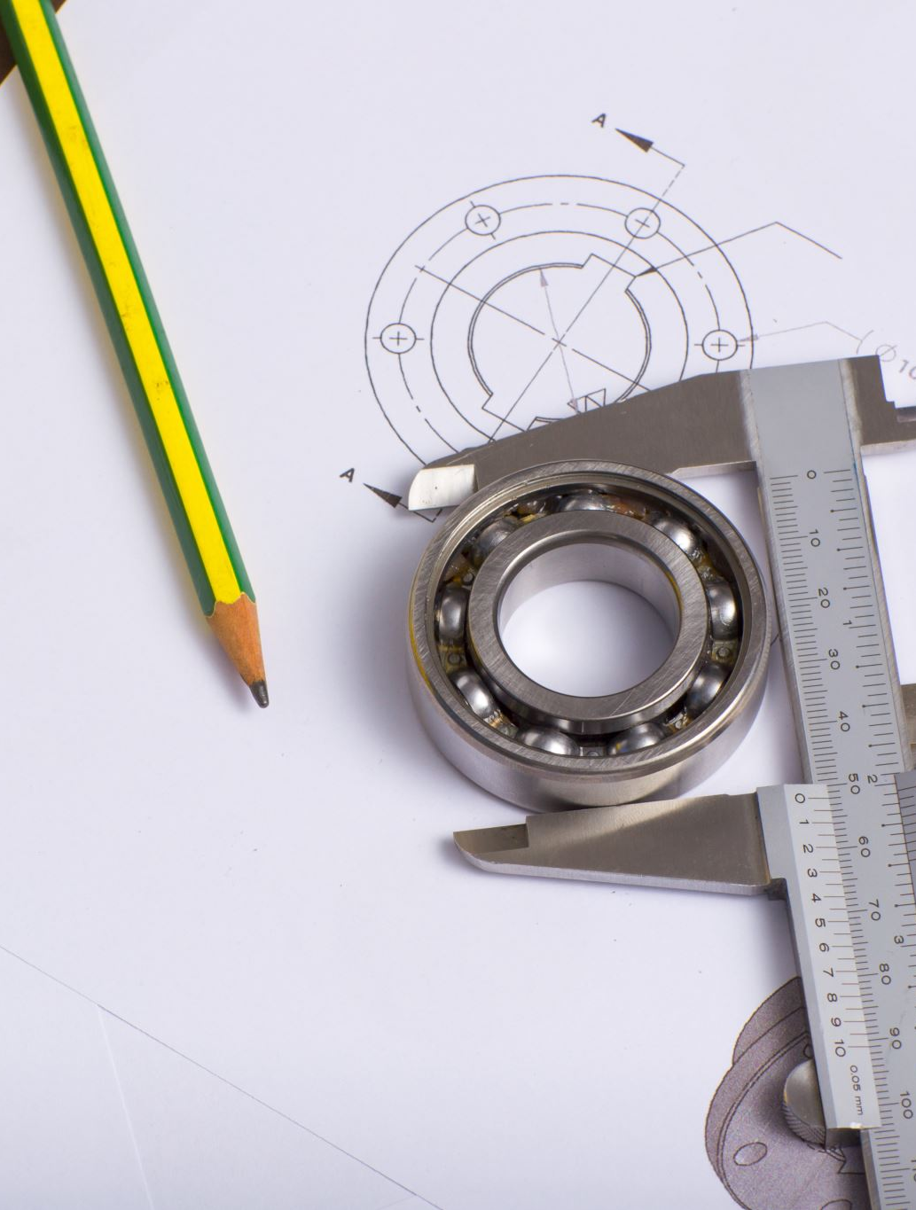
Bearing and Bearing Fault Detection -CONTD
Overview of Bearings and Common Failures
Role of Bearings: Bearings are critical in supporting rotating parts in equipment, reducing friction, and allowing smooth motion.
Common Failures: Wear, fatigue, misalignment, contamination, and poor lubrication can lead to increased friction and vibration.
Need for Proactive Testing: Bearing failures often result in costly downtime or catastrophic equipment damage, making early detection crucial.
Why Ultrasound?: Ultrasound testing is highly sensitive to friction and impact noises, making it ideal for early-stage bearing fault detection.

Slide 54
Bearing and Bearing Fault Detection -CONTD
How Ultrasound Detects Bearing Faults
Ultrasound Technology: Ultrasonic waves pick up high-frequency sounds that indicate friction, impacting parts, or turbulent lubrication flow inside the bearing.
Unique Testing Approaches:
Friction Noise Detection: Early signs of bearing wear or misalignment create distinct ultrasonic signals.
Lubrication Check: Detects over-lubrication (indicating build-up) or under-lubrication (indicating dry running).
Contact Testing: A transducer placed directly on the bearing housing captures precise fault signals like brinelling (indents on rolling elements).
Advantages: Sensitive enough to catch small faults that traditional vibration analysis might miss.

Slide 55
Bearing and Bearing Fault Detection
Industrial Applications and Benefits of Ultrasound for Bearing Monitoring
Widespread Use: Applied in sectors like power generation, food processing, and heavy machinery, where equipment reliability is essential.
Key Benefits:
Minimizing Unexpected Downtime: Early detection allows for predictive maintenance rather than reactive, unplanned repairs.
Prolonging Bearing Life: Continuous monitoring helps prevent severe wear, extending the lifespan of components.
Enhanced Efficiency: Optimizes lubrication schedules and reduces energy consumption by keeping bearings in optimal condition.

Slide 56
Section 12: Bearing Lubrication

Slide 57
Bearing Lubrication -CONTD
Importance of Proper Bearing Lubrication
Role of Lubrication: Reduces friction, prevents wear, and protects against contamination in bearings.
Challenges in Lubrication: Over-lubrication leads to increased heat and energy loss, while under-lubrication causes excessive wear and friction.
Why Ultrasound for Lubrication?: Ultrasound testing can accurately assess lubrication levels by detecting friction-related sound changes in bearings.

Slide 58
Bearing Lubrication
How Ultrasound Testing Detects Lubrication Issues
Principle of Ultrasound: Bearings emit specific high-frequency sounds when under or over-lubricated.
Testing Process:
Sound Analysis: Ultrasound sensors monitor friction levels, alerting when lubrication is insufficient or excessive.
Lubrication Feedback: Real-time adjustments can be made based on the sound data, ensuring optimal lubrication levels.
Contact Measurement: A sensor placed on the bearing housing provides immediate detection of improper lubrication.
Benefits: Prevents both over-lubrication (leading to heat and energy loss) and under-lubrication (leading to wear and failure).

Slide 59
Section 13: Mechanical Inspection

Slide 60
Mechanical Inspection -CONTD
The Role of Mechanical Inspections in Industry
Mechanical Systems Overview: Mechanical components like shafts, gears, pumps, and valves are vital for smooth operations in industries such as manufacturing, power generation, and transport.
Need for Regular Inspections: Mechanical systems are subject to wear, misalignment, and stress over time, making regular inspections essential to prevent failures.
Ultrasound Testing Overview: A fast, non-invasive technique for detecting mechanical faults like friction, leaks, and structural weaknesses before they escalate.

Slide 61
Mechanical Inspection -CONTD
Ultrasound Testing Process for Mechanical Systems
Key Techniques:
Leak Detection: Detects small leaks in pressurized systems, such as hydraulic cylinders or air compressors.
Structural Integrity: Identifies loose parts, cracks, or misalignment in rotating equipment by analyzing sound patterns.
Unique Feature: Ultrasound can be used while machinery is operating, enabling real-time monitoring without halting production.

Slide 62
Mechanical Inspection
Advantages of Ultrasound Testing in Mechanical Inspection
Predictive Maintenance: Ultrasound data enables early detection of potential failures, allowing timely maintenance that reduces costly downtimes.
Energy Efficiency: Identifying inefficiencies, like excessive friction or leaks, can improve system performance and reduce energy consumption.
Case Example: In a power plant, ultrasound testing revealed misaligned gears in a turbine, preventing a costly shutdown.

Slide 63
Section 14: Tightness and Integrity

Slide 64
Tightness and Integrity
Tightness and Integrity in Industrial Systems
Tightness & Integrity: Essential for maintaining the performance and safety of systems such as pipelines, storage tanks, and pressurized vessels.
Potential Issues: Leaks, pressure loss, and structural weakness can compromise system integrity, leading to costly failures or safety hazards.
Ultrasound Testing: An effective method for detecting small leaks, cracks, and flaws in sealing or weld integrity without disassembling components.

Slide 65
Section 15: Reporting

Slide 66
Reporting
Reporting in Ultrasound Testing
Data Collection: Ultrasound testing generates high-frequency sound data that is analyzed to detect faults like leaks, cracks, or structural defects.
Analysis & Interpretation: The collected data is processed and interpreted by technicians to assess the severity of the detected issues.
Reporting: Detailed reports are generated, including:
Test Results: Identified faults, location, and severity.
Recommendations: Suggested repairs, maintenance actions, or continued monitoring.
Documentation: Graphs, sound wave patterns, and images to support findings.
Importance: Clear and accurate reporting ensures timely corrective actions, improves maintenance strategies, and enhances system reliability.

Slide 67
Thank you
If you have any questions ?
Contact us :
Sales@globaltech-innovations.com
+92-3325335177
https://globaltech-innovations.com/stage/

