Slide 1
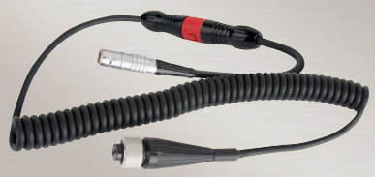
PRACTICAL TIPS FOR IDENTIFYING AND TROUBLESHOOTING PORTABLE MEASUREMENT CABLES FOR VIBRATION ANALYSIS
LEVEL 3 – LESSON 1

Slide 2
OBJECTIVES
Troubleshooting vibration analysis hardware is an important tool in the vibration analysts’ toolbox.
Knowing what to look for and how to isolate the problem with vibration analysis cables contributes to the prevention of other problems in the future.
This lesson focuses on cabling problems in portable systems.

Slide 3
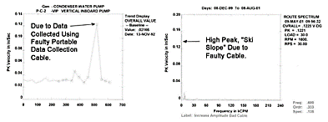
HARDWARE PROBLEMS
Common Issues:
Data Collection Failures
Collecting measurement points all day, only to find the data cannot be used after downloading.
Database Problems
Downloading data into a database but unable to remove the measurement point due to a suspect reading.
Cable Issues
Collecting data with one cable while the system shows erroneous readings with the spare cable miles away.
Training Focus:
Tips and insights into diagnosing and correcting cabling issues.

Slide 4
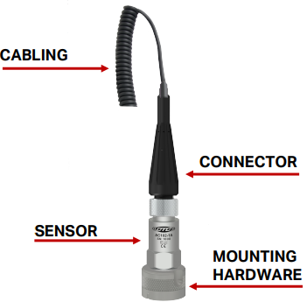
PORTABLE DATA CABLES
The cabling provides the path for the accelerometer output to the data collector.
It is also the path for powering the accelerometer.
Connectors attach the cable from the accelerometer to the data collector or a junction box.

Slide 5
Troubleshooting Tips / Techniques:
Identify the Problem:
Fault ID / Visual Inspection:
Understand and identify the exact fault.
Questions to Consider:
What types of error(s) are being observed?
Are there any nicks, cuts, scratches, or burn marks on the cable?
Is there any corrosion on the connector sockets?
Corrective Actions / Solutions:
Diagnose specific issues based on observations.
Implement solutions to resolve identified faults.
Extend Cable Life:
Follow tips and best practices to ensure cables last longer and perform reliably.

Slide 6
TROUBLSHOOTING CHART
The troubleshooting chart on the following pages was developed to help an analyst determine a fault by matching the situation to what is being observed in the field.
Note: You will see the importance of using both the spectrum and the time waveform to help understand the full picture.

Slide 7
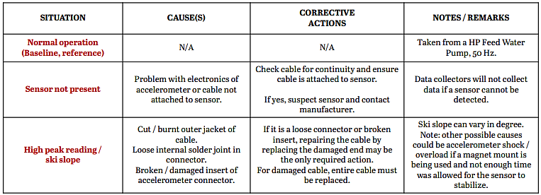
TROUBLSHOOTING CHART

Slide 8
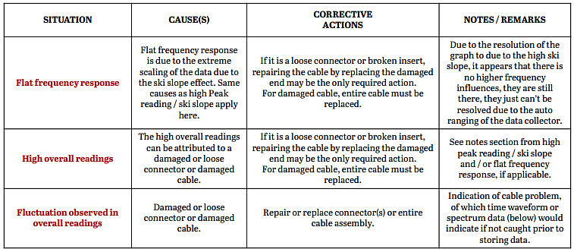
TROUBLSHOOTING CHART

Slide 9
TROUBLSHOOTING CHART

Slide 10
Further Explanation of Causes in Vibration Analysis Hardware
Connector Problems:
Broken Connector Insert:
Common in two socket connectors with hard plastic isolation inserts.
Constant handling weakens inserts, leading to cracks or complete fallout.
Damaged inserts cause interference on pins from the accelerometer, resulting in high readings and suspect data.
Loose Solder Joints:
Indicated by erratic or intermittent readings when moving the cable.
Hard to pinpoint as joints are often potted with adhesive, making them unobservable without destroying the connector.
Damaged Cable:
Cut or Burnt Cable:
Exposes shielding and can cut or burn internal twisted-shielded wires.
Causes signal contamination, leading to signal fluctuations and the ski-slope effect in spectrums.

Slide 11
Extending Cable Life – Tips on Preparing for Cable Faults
Corrective Actions / Solutions:
Repairing or replacing problem cables is often necessary.
Tips for extending cable life:
Have Spare Cables on Hand:
Ensure spare cables are available for troubleshooting and replacements.
Maintenance / Inspection:
Keep cables free of dirt, oils, and contaminants.
Clean connector contacts and check for corrosion.
Inspect connectors for damage or cracks.
Check cables for cuts, nicks, or burns.
Minimize elongation of coiled cables.

Slide 12
Extending Cable Life – Tips on Preparing for Cable Faults
Care During Use:
Avoid laying cables on or near hot surfaces (>250°).
Use high-temperature cables around hot equipment.
Cable Manufacturer Warranty:
Choose cables with a lifetime warranty.
Select high-quality cables built for extended life, like CTC's cables.
Proactive Connector Development:
Strain Relief and Reinforcements:
Custom strain reliefs reduce stress on solder joints and cables.
Adhesive-filled connectors provide structural reinforcement and environmental protection.
Material Changes:
Use soft neoprene isolation inserts instead of hard plastic to prevent cracking and breaking.

Slide 13
Conclusion
The condition of your cabling has a direct impact on the quality of the data collected. Many false alarms and / or time spent trying to track down a machine fault that really isn’t there can be avoided if you know what to look for when observing data that seems out of the ordinary. A good first step to any problem or observed inconsistency is to isolate the problem and start looking at possible causes and solutions.
TYPICAL OBSERVED DATA
High overall vibrations for measurements
Significant changes in recorded vibration
‘Ski Sloping’ of data in the spectrum at points < 1 Hz (60 CPM) and / or intermittent signals as indicated by the data collector
TYPICAL CAUSES
Damaged cable (burnt or cut cable)
Damaged connector (2 socket isolation material / insert)
Looseness of solder joints
TYPICAL SOLUTIONS
Repair or replace the cables

