Slide 1
WHAT’S UP WITH BUMP TESTING?
LEVEL 3 – LESSON 2

Slide 2
OBJECTIVES
Upon completing the following lesson, you will understand the basics of bump testing, including:
What is a bump test?
Why do a bump test?
How do bump tests work?

Slide 3
BUMP TESTING – WHAT IS A BUMP TEST?
A bump test is the measured response of an impact to an object
The force of the impact is not controlled or measured
The response of the object is not controlled, but is measured
A single channel response measurement

Slide 4
BUMP TESTING – WHY DO A BUMP TEST?
Bump testing is done to excite and measure the natural frequency(s) of an object. When bump testing is done, you will:
Identify a resonance
Understand a change in mass
Understand a change in stiffness
Understand a change in damping

Slide 5
BUMP TESTING – HOW DOES IT WORK?

Slide 6
BUMP TESTING – SINE WAVES?

Slide 7
BUMP TESTING – BUMPS FROM SINE WAVES?

Slide 8
BUMP TESTING – 100TH HARMONIC

Slide 9
BUMP TESTING – 50TH HARMONIC

Slide 10
BUMP TESTING – 20TH HARMONIC

Slide 11
BUMP TESTING – 10TH HARMONIC

Slide 12
BUMP TESTING – 5TH HARMONIC

Slide 13
BUMP TESTING – 4TH HARMONIC

Slide 14
BUMP TESTING – 3RD HARMONIC

Slide 15
BUMP TESTING – 2ND HARMONIC

Slide 16
BUMP TESTING – FUNDAMENTAL

Slide 17
BUMP TESTING – 2ND HARMONIC

Slide 18
BUMP TESTING – 3RD HARMONIC

Slide 19
BUMP TESTING – 4TH HARMONIC

Slide 20
BUMP TESTING – 5TH HARMONIC

Slide 21
BUMP TESTING – 10TH HARMONIC

Slide 22
BUMP TESTING – 20TH HARMONIC

Slide 23
BUMP TESTING – 50TH HARMONIC

Slide 24
BUMP TESTING – 100TH HARMONIC

Slide 25
BUMP TESTING – HOW DOES IT WORK?
Bump testing or impact testing works because the bump or impact contains all of the individual frequencies or sign waves
When you bump or impact the object under test, you will excite all of the natural frequencies of that object

Slide 26
BUMP TESTING – WHAT DO YOU IMPACT WITH?
Pin Drops
High frequency content
Low energy value
Cow Plops
Low frequency content
High energy value

Slide 27
BUMP TESTING – ENERGY VALUE vs. FREQUENCY
The item used to deliver the impact to the object under test will determine the energy that is delivered to the object:
Large objects with considerable mass should be impacted with rubber or wood. This will generate high energy, low frequency responses (cow plops).
Small objects with considerable stiffness should be impacted with metal or hard plastics. This will generate low energy, high frequency responses (pin drops).

Slide 28
BUMP TESTING – SET UP
UNIFORM WINDOW
Take your time – bump around
Do not over range or clip the input signal
800 – 1600 lines of resolution
Try some different frequency spans
Only one bump for each time record
About four averages (depends on noise)

Slide 29
BUMP TESTING – WHY THE UNIFORM WINDOW?

Slide 30
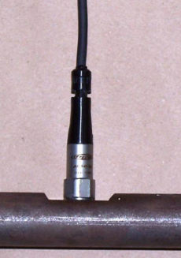
BUMP TESTING – WHAT TO BUMP?
1” diameter steel round stock
36” length
Clamped in “V” blocks at each end
AC140 accelerometer stud mounted on center (100 mV/g)

Slide 31
BUMP TESTING – BUMP IT! TWO RESPONSES!

Slide 32
BUMP TESTING – MENTAL HEALTH CHECK!

Slide 33
CASE HISTORY
BUMPS IN THE ROAD!

Slide 34
CASE HISTORY – SO EASY!

Slide 35
CASE HISTORY – ZOOM

Slide 36
CASE HISTORY – ZOOM & MENTAL HEALTH CHECK

Slide 37
CASE HISTORY – SO EASY?

Slide 38
CASE HISTORY – WHAT IS THIS?

Slide 39
CASE HISTORY – LOG: CAN’T LIVE WITH IT, CAN’T LIVE WITHOUT IT!

Slide 40
CASE HISTORY – 0–50 Hz SPAN

Slide 41
CASE HISTORY – 0–50 Hz (EXPANDED “X” SCALE)

Slide 42
BUMP TESTING – BACK TO BUMP TESTING

Slide 43
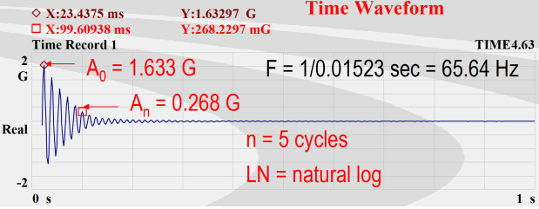
AMPLIFICATION FACTOR – USING THE TIME WAVEFORM
Log decrement = [1/n[LN(A0/An)]] = [1/5[LN(1.633/0.268)]] = 0.36
Damping ratio = Log dec/2Pi = 0.36/2Pi = 0.36/6.28 = 0.057
Amplification factor = 1/(2*Damping) = 1/(2*0.057) = 8.68

Slide 44
AMPLIFICATION FACTOR – USING THE SPECTRUM

Slide 45
DAMPING – CONTROL THE RESPONSE

Slide 46
CONCLUSION
Take your time
Choose your weapon
Bump around
Uniform window
Look at the time waveform
Look at the frequency spectrum
Do a mental health check
Calculate the amplification factor
Change the mass
Change the stiffness
Add damping
Bump around

