Slide 1
TWO WIRE 4-20 mA SENSORS AND FOUR WIRE TRANSMITTERS
LEVEL 3 – LESSON 3

Slide 2
OBJECTIVES
Upon completing the following lesson, you will understand the basic application and benefits of:
Two wire 4-20 mA loop power sensors
Four wire transmitters

Slide 3
TWO WIRE 4-20 mA SENSORS
Two wire loop power sensors require only two connections:
+18 to 30 volt power lead
DC common (negative) lead
The sensor regulates the loop so that the current is proportional to the vibration parameter being measured.

Slide 4
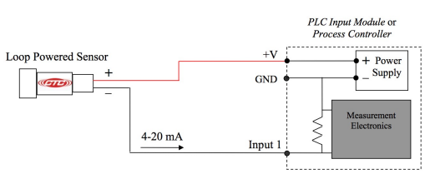
TWO WIRE 4-20 mA SENSORS
The sensors can be wired directly into analog input modules on PLCs or Process Controllers that accept 4-20 mA signals
The sensor must be connected to a power source at the positive lead and the common (negative) lead will be connected to the Controller’s analog input
The power supply is used to complete the loop through the Controller’s ground

Slide 5
TWO WIRE 4-20 mA SENSORS

Slide 6
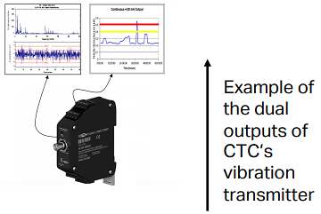
FOUR WIRE 4-20 mA TRANSMITTERS
Vibration transmitters constitute a more versatile approach to continuous monitoring than the standard loop powered sensors.
The transmitters are capable of wider frequency and amplitude ranges and can provide a dynamic vibration signal in addition to the overall 4-20 mA output.
The dynamic vibration signal is available through a buffered output.

Slide 7
FOUR WIRE 4-20 mA TRANSMITTERS
The four wires needed to monitor overall vibration level using a transmitter are:
Positive and negative power supply leads that will provide power to the electronics
Positive and negative output signal leads
These two pairs of leads are separate and distinct from one another. The figure below shows typical wiring into a PLC or process controller with analog input module.
A two conductor cable with a plug (F) type BNC connector can be used to monitor the dynamic vibration signal coming out of the BNC jack on the transmitter.

Slide 8
Thank you!
Any queries?
Contact us:
sales@GTI.xyz
+92-XXXXXXX

