Slide 1
APPLICATION OF CONDUCTIVE MOUNTING PADS FOR VIBRATION ANALYSIS IN INTRINSICALLY SAFE ENVIRONMENTS
LEVEL 3 – LESSON 4

Slide 2
OBJECTIVES
Upon completing the following lesson, you will understand the benefits and disadvantages of the various methods used for mounting accelerometers in intrinsically safe (IS) environments.

Slide 3
INSTALLATION REQUIREMENTS
The installation of accelerometers to measure machine vibration in an intrinsically safe (IS) environment requires that the case of the accelerometer be at the same electrical potential as the machine to which it is mounted. Typically, this is earth ground.

Slide 4
STUD MOUNTING
Normal Method:
Procedure:
Drill, spot face, and tap a threaded hole in the machine.
Ensure metal-to-metal contact for conductivity.
Steps:
Machine a small, circular flat surface.
Drill and tap a 1/4-28 hole in the center.
Attach the accelerometer with a threaded stud.
Tighten with a mounting torque of 2 to 5 ft lbs.
Disadvantages:
Motor Manufacturer Concerns:
Potential failure due to modification of explosion-proof motor cases.
Intrinsic safety (IS) requirements might be compromised.
Need for Alternative Methods:
Context:
Manufacturers recognize the benefits of vibration monitoring.
Alternate mounting methods are necessary to maintain IS compliance.

Slide 5
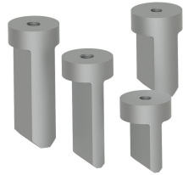
FIN MOUNT PADS
The fin mount pad is a universally accepted method of mounting accelerometers on motors, and is available in various sizes.

Slide 6
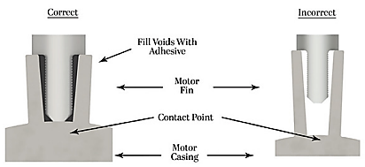
FIN MOUNT PADS
The fin mount pad is seated in the valley between two cooling fins on the motor, and is held in place with epoxy.

Slide 7
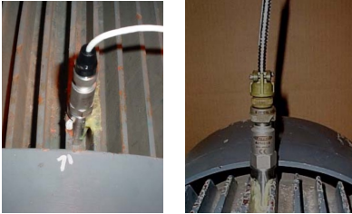
FIN MOUNT PADS
The accelerometer is then stud mounted or magnet mounted to the fin mount pad to measure the vibration of the motor.
A typical epoxy used in this case is Devcon Plastic Welder. Although it has very good adhesive properties, and a shore D hardness of 78 providing good transmission of vibrations, it is an insulator and will not meet the requirements for intrinsic safety (IS).

Slide 8
Fin Mount Pads – Using a Conductive Epoxy
Problem with Insulating Epoxy:
Issue:
Typical Devcon Plastic Welder is insulating.
Cannot maintain a conductive bond between accelerometer, fin mount pad, and motor.
Solution:
Conductive Epoxy:
Example Product: TIGA 901
Provider: Resin Technology Group, LLC
Description:
Electrically conductive, silver-filled epoxy adhesive.
Suitable for electronics bonding and sealing applications.
Combines good mechanical and electrical properties.
TIGA 901 Features:
Composition:
Two-part smooth paste of refined pure silver and epoxy.
Free of solvents, copper, or carbon additives.
Benefits:
Develops strong, durable, electrically, and thermally conductive bonds.
Suitable for metals, ceramics, glass, and plastic laminates.
Cures at room temperature.
Can be used as a 'cold solder' for heat-sensitive components.
Usage:
Packaging:
Available in a 2.5-gram burst pack for easy mixing.
Cure Time:
Requires 24 hours at room temperature.
Performance:
Shore D hardness of 85.
Excellent for the transmission of vibration.

Slide 9
FIN MOUNT PADS – CONDUCTIVE EPOXY MOUNTING PROCEDURE
Once the location on the motor has been identified to place the fin mount pad, the valley between the motor fins needs to have the paint removed so that there is a bare metal surface to work with.
This surface preparation must include the valley between the fins and both inside walls of the fins.
A sharp bladed scraper or a wire wheel in a drill motor will assist with the surface preparation

Slide 10
FIN MOUNT PADS – CONDUCTIVE EPOXY MOUNTING PROCEDURE
Mix the TIGA 901 and apply it into the valley between the two motor fins. Set the tip of the fin mount pad in the TIGA 901 and temporarily fix it in place for the 24 hour curing cycle. Make sure that only the tip of the fin mount pad is touching the motor case, and that clear space exists on the sides and top of the fin mount pad. An example is shown below:

Slide 11
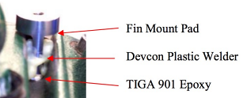
FIN MOUNT PADS – CONDUCTIVE EPOXY MOUNTING PROCEDURE
After the 24 hour curing cycle, the Devcon Plastic Welder can be added to fill the voids between the walls of the motor fins and the fin mount pad.
This provides added strength to the mounting, but does not compromise the conducive bond that was established with the TIGA 901.
This secondary epoxy fill will reduce the mounting costs and provide side wall support, as shown to the left.

Slide 12
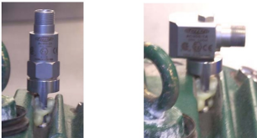
FIN MOUNT PADS – CONDUCTIVE EPOXY MOUNTING PROCEDURE
In tight locations the Devcon Plastic Welder could be applied with a syringe and taper tip to facilitate filling the voids between the walls of the motor fins and the fin mount pad. Once the Devcon Plastic Welder has cured (approximately 5-10 minutes), any bare metal may be painted, and the accelerometer may be mounted. Below are examples of mounting a top exit or side exit accelerometer on the motor fin mount pad.

Slide 13
CONCLUSION
A successful accelerometer mounting has been achieved without altering the physical structure of the motor.
Utilizing TIGA 901 and Devcon Plastic Welder has provided a conductive mounting method at the lowest possible cost with added strength to support the fin mount pad.
The actual measured resistance between the fin mount pad and the motor case ranged from 0.1 to 0.2 ohms, and provides safe mounting of the accelerometer in an intrinsically safe (IS) environment

Slide 14
THANK YOU!
Any queries?
Contact us:
sales@GTI.xyz
+92-xxxxxxxx

