Slide 1
LEVEL 3 – LESSON 6 MEASURING FAN AND MOTOR VIBRATIONS

Slide 2
OBJECTIVES
Upon completing the following lesson, you will understand the fundamentals of using vibration monitoring to analyze faults and prevent machine failure of fans and motors in industrial environments.
3 | LEVEL 3, LESSON 6 – MEASURING FAN AND MOTOR VIBRATION

Slide 3
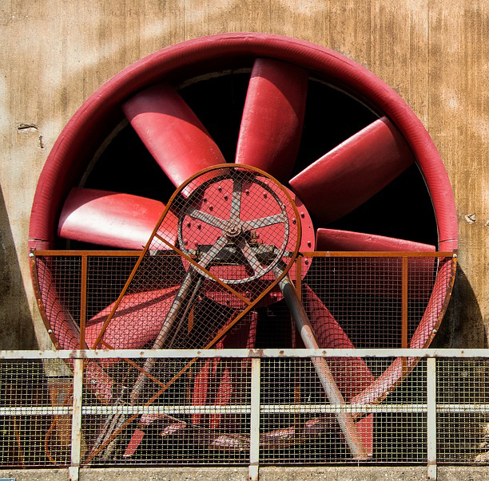
UNDERSTANDING FANS AND MOTORS
Quite often we view the fans and motors that we rely on as very common machines.
We forget that they provide critical air flows for industrial processes, and cooling, heating, humidification, and dehumidification for office buildings, convention centers, theaters, recreational facilities, and hotels.
4 | LEVEL 3, LESSON 6 – MEASURING FAN AND MOTOR VIBRATION

Slide 4
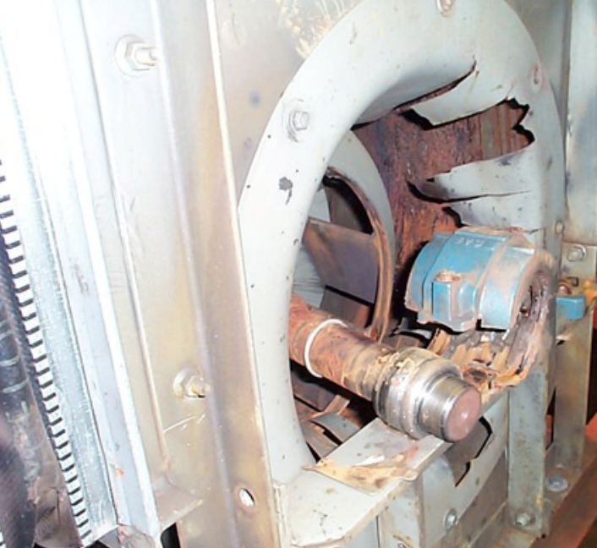
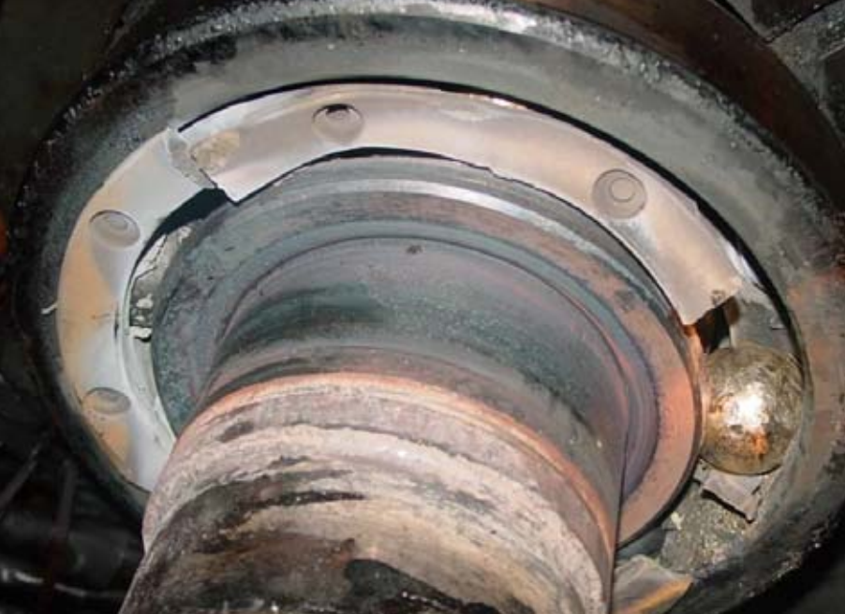
UNDERSTANDING FANS AND MOTORS – COMMON MODE OF FAILURE
Although they come in many shapes and sizes, fans and motors share a common mode of failure.
Bearings are often overlooked and overworked, suffering from lack of lubrication, too much heat, or poor applications. When this happens, the bearings wear and deteriorate, generating vibrations.
Measuring the vibration and analyzing the faults will prevent catastrophic failures, as shown in the photos:
5 | LEVEL 3, LESSON 6 – MEASURING FAN AND MOTOR VIBRATION

Slide 5
UNDERSTANDING FANS AND MOTORS – PREVENTING FAILURE
A good routine vibration program using a portable data collector, or permanent online vibration monitoring, will become the foundation of any predictive maintenance initiative.
Measuring, trending, alarming, and analyzing fan and motor vibration will provide earlier warning of developing problems and allow replacement parts to be ordered.
Bearings can be replaced during scheduled down times prior to non-repairable damage occurring.
6 | LEVEL 3, LESSON 6 – MEASURING FAN AND MOTOR VIBRATION

Slide 6
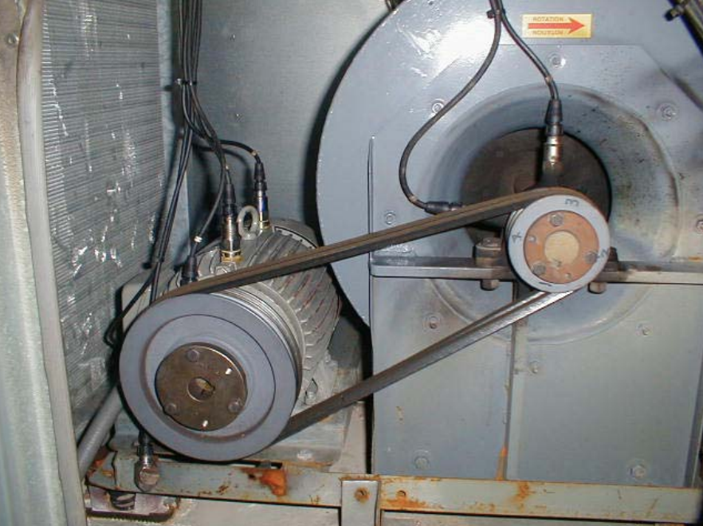
SENSOR PLACEMENT FOR FANS AND MOTORS
Accelerometers are typically placed at key locations on the motor and fan bearings.
Since the bearings are the load carrying part of the mechanical drive train, accelerometers should be placed on the input and output bearing housing to measure the vibration levels.
In this photo, you can see permanent accelerometers placed on motor and fan bearings:
7 | LEVEL 3, LESSON 6 – MEASURING FAN AND MOTOR VIBRATION

Slide 7
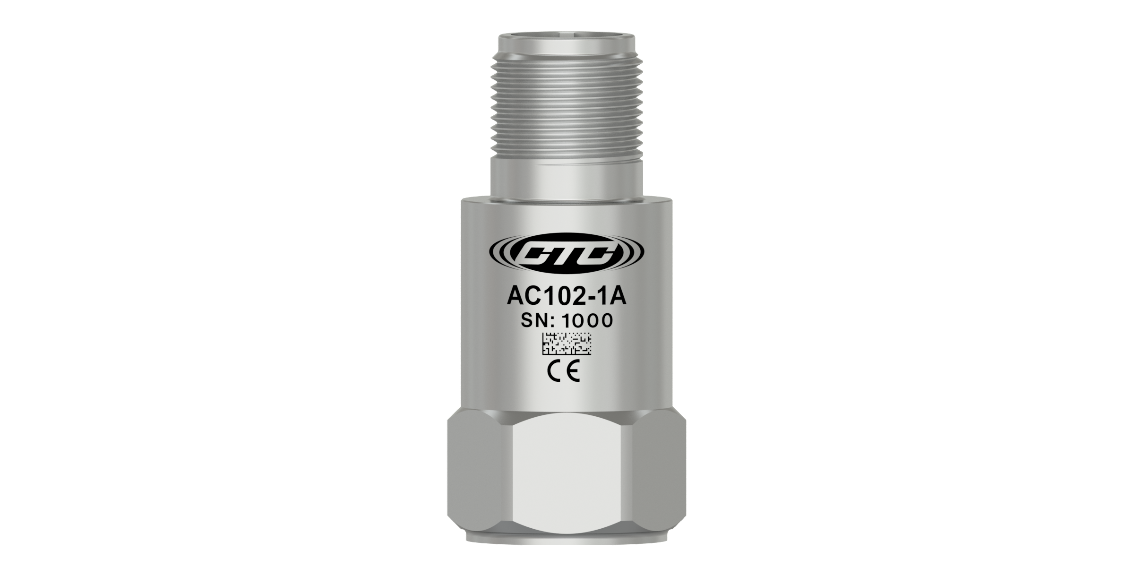
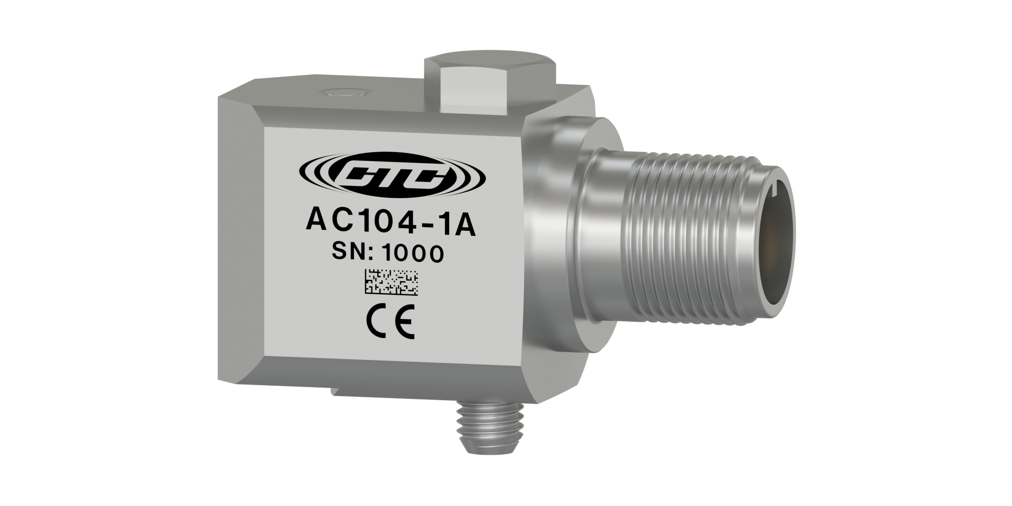
SENSOR PLACEMENT FOR FANS AND MOTORS
Vibration sensors should be placed in radial (horizontal and vertical) and axial locations on the motor and fan bearings. This will provide the best detection of all vibration components, including:
Bearing vibration
Unbalance
Misalignment
Electrical faults
Blade pass (aerodynamic disturbances)
Belt frequencies
8 | LEVEL 3, LESSON 6 – MEASURING FAN AND MOTOR VIBRATION

Slide 8
PORTABLE MOUNTING METHODS
There are three common mounting methods used with portable vibration measurements:
Curved surface magnet
Quick disconnect
Flat surface magnet and target
9 | LEVEL 3, LESSON 6 – MEASURING FAN AND MOTOR VIBRATION

Slide 9
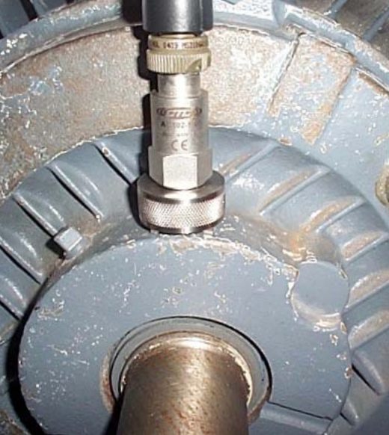
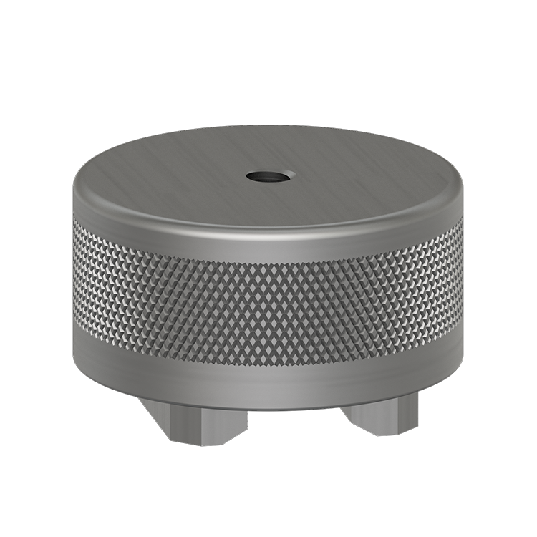
PORTABLE MOUNTING METHODS – CURVED SURFACE MAGNET
Mounting sensors with a curved surface magnet is convenient for, and fits well on, rounded surfaces.
Frequency response – 2,000 Hz
Offers repeatability based on user mounting
10 | LEVEL 3, LESSON 6 – MEASURING FAN AND MOTOR VIBRATION

Slide 10
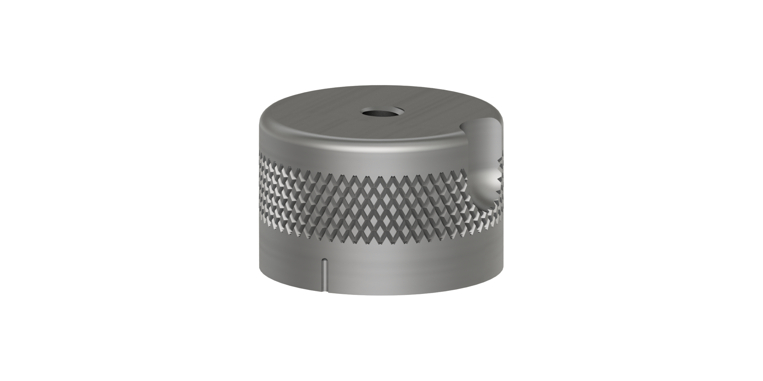
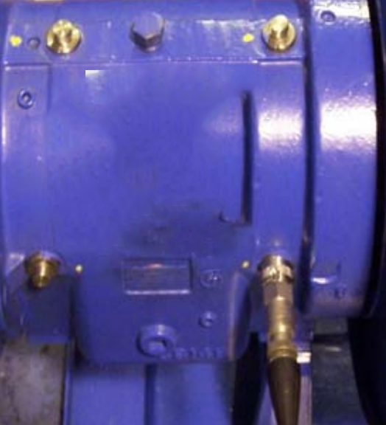
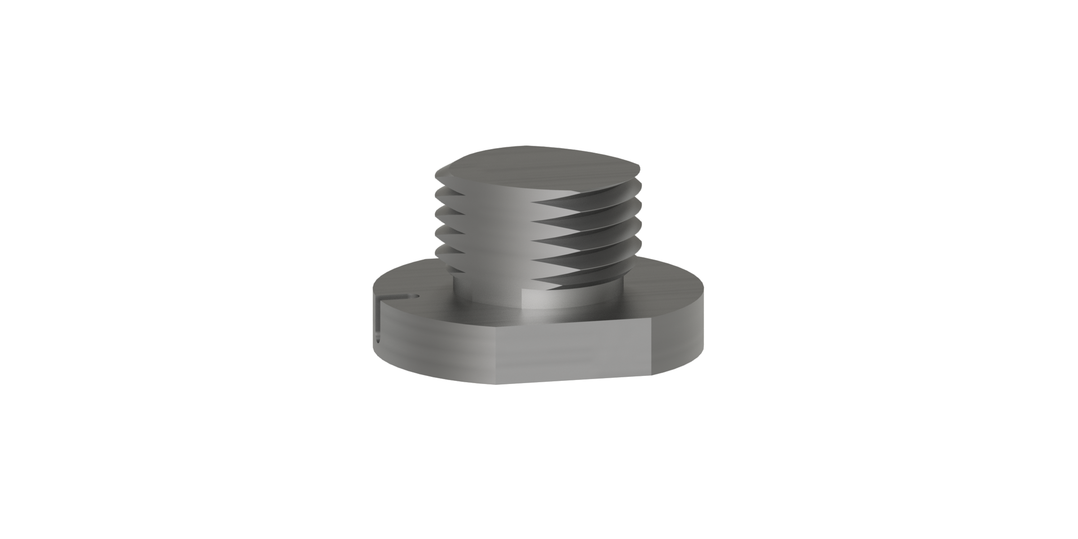
PORTABLE MOUNTING METHODS – QUICK DISCONNECTS
Mounting sensors with quick disconnects is convenient for mounting on a permanent target.
Frequency response – 6,500 Hz
Offers excellent repeatability
11 | LEVEL 3, LESSON 6 – MEASURING FAN AND MOTOR VIBRATION

Slide 11
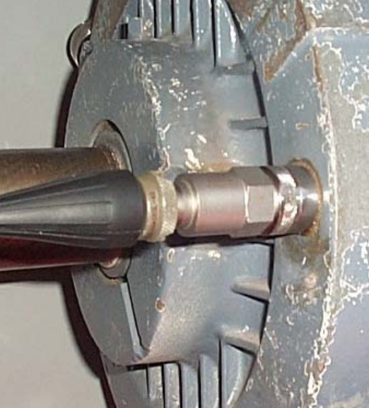
PORTABLE MOUNTING METHODS – FLAT SURFACE MAGNET AND TARGET
Mounting sensors with a flat surface magnet and target is convenient for mounting on a permanent target.
Frequency response – 10,000 Hz
Offers excellent repeatability
12 | LEVEL 3, LESSON 6 – MEASURING FAN AND MOTOR VIBRATION

Slide 12
PERMANENT MOUNTING METHODS
There are two common mounting methods used with permanent vibration measurements:
Adhesive surface mounting
Stud mounting
Both of these methods require surface preparation prior to mounting the sensor.
13 | LEVEL 3, LESSON 6 – MEASURING FAN AND MOTOR VIBRATION

Slide 13
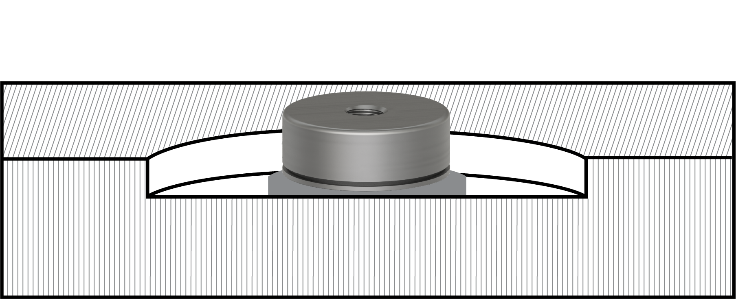
PERMANENT MOUNTING METHODS – ADHESIVE SURFACE MOUNTING
Adhesive surface mounting requires a clean, dry, flat surface before cementing the mounting pad to the machine.
14 | LEVEL 3, LESSON 6 – MEASURING FAN AND MOTOR VIBRATION

Slide 14
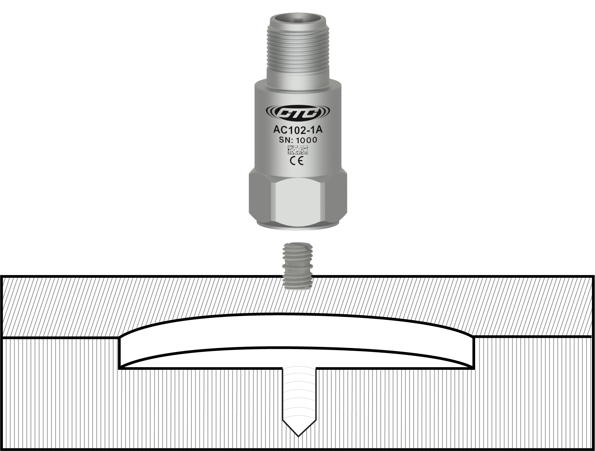
PERMANENT MOUNTING METHODS – STUD MOUNTING
Stud mounting requires a spot face with a drilled and tapped hole.
15 | LEVEL 3, LESSON 6 – MEASURING FAN AND MOTOR VIBRATION

Slide 15
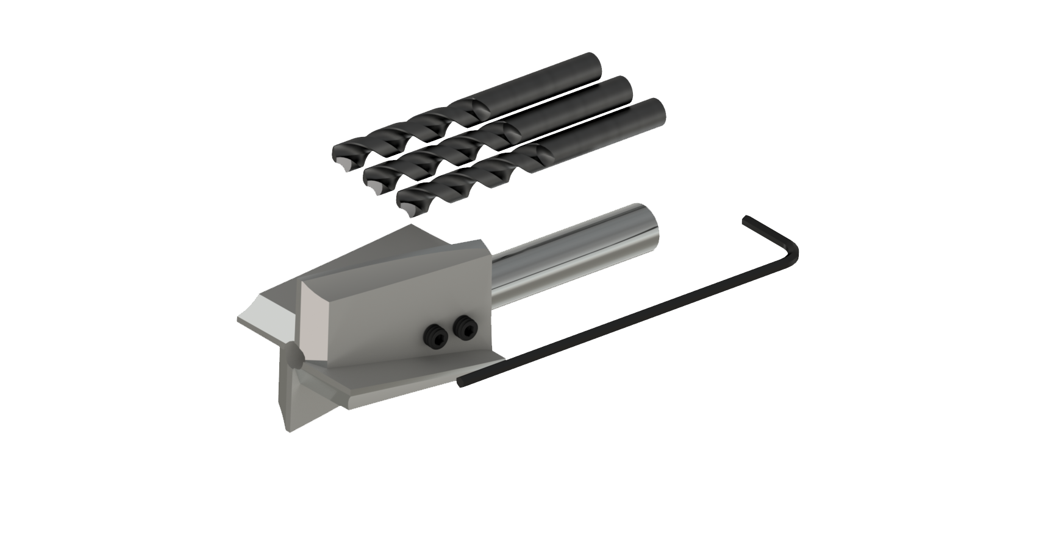
PERMANENT MOUNTING METHODS – SPOT FACING
Since both methods require a flat prepared surface for mounting, spot facing is the easiest way to accomplish this.
A spot facing tool can provide the flat surface and drill the hole in one operation.
16 | LEVEL 3, LESSON 6 – MEASURING FAN AND MOTOR VIBRATION

Slide 16
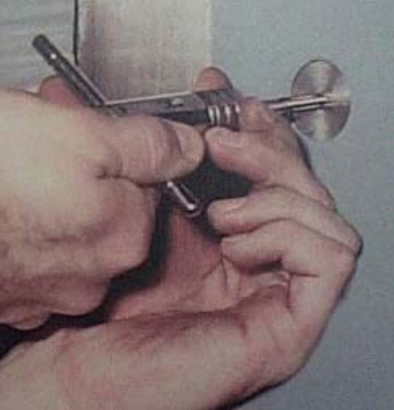
PERMANENT MOUNTING METHODS – FREQUENCY RESPONSE
If the correct care is taken during permanent mounting, a frequency response of 15,000 Hz should be achievable using an adhesive mount.
The maximum frequency response of the accelerometer should be achievable using a stud mount.
17 | LEVEL 3, LESSON 6 – MEASURING FAN AND MOTOR VIBRATION

Slide 17
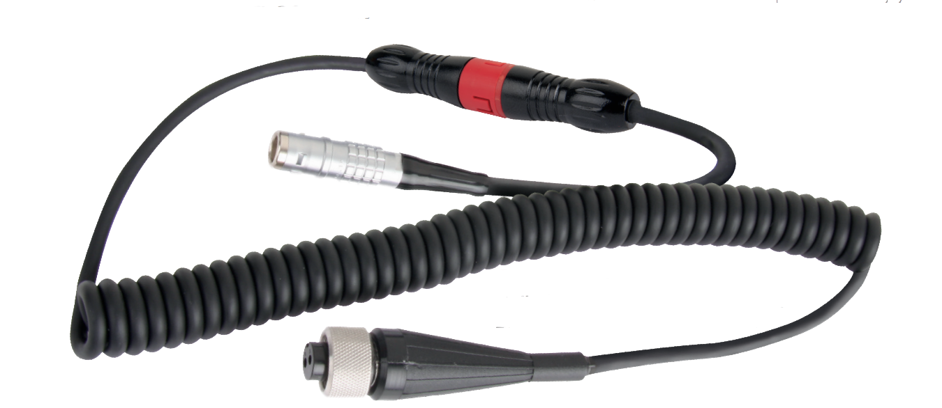
PORTABLE CABLES AND CONNECTORS
Portable data collection requires a flexible cable and a connector with good strain relief.
It needs to be easy to use, but also very rugged for repetitive bending and stretching.
The twisted shielded wiring pairs minimize noise.
18 | LEVEL 3, LESSON 6 – MEASURING FAN AND MOTOR VIBRATION

Slide 18
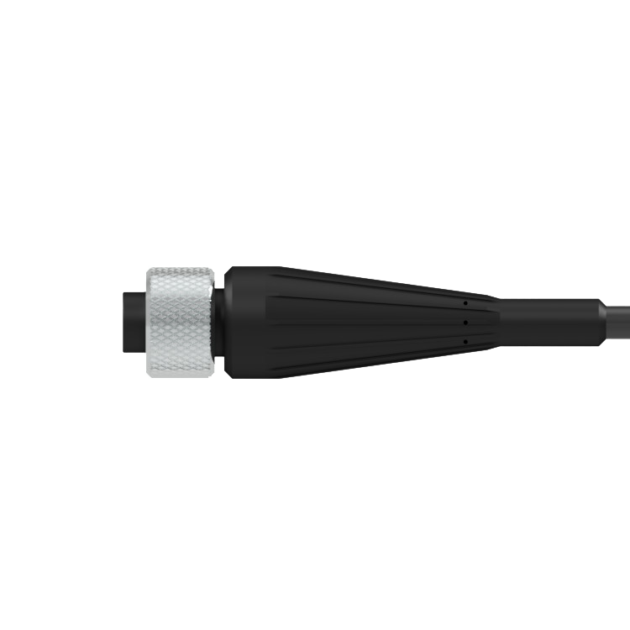
PORTABLE CABLES AND CONNECTORS
The sensor connector on the cable should be soldered, have a good strain relief, and fit comfortably in your hand.
19 | LEVEL 3, LESSON 6 – MEASURING FAN AND MOTOR VIBRATION

Slide 19
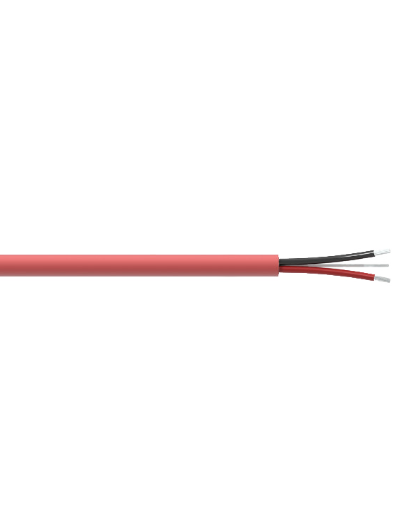
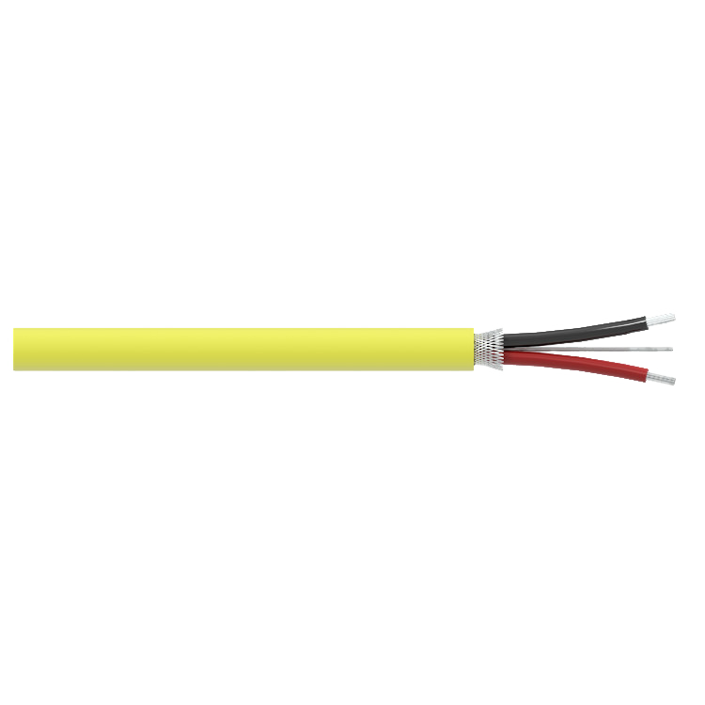
PERMANENT CABLES AND CONNECTORS
Permanent data collection utilizes a very rugged cable and connector that is intended to stay in place for the life of the machine.
Cables should have heavy duty jackets to protect them from abrasion and the surrounding environment.
Many applications utilize FEP jackets, and for severe environments, stainless steel armor jackets can be used.
20 | LEVEL 3, LESSON 6 – MEASURING FAN AND MOTOR VIBRATION

Slide 20
PERMANENT CABLES AND CONNECTORS
Connectors for permanent data collection should also be chosen based on the application and environment.
Temperature and Ingress Protection (IP) against liquids and dust should always be considered.
Chemical contact should also be reviewed and planned for when choosing a connector or cable.
Choose the cable and connector that fits your application to avoid a weak link in the vibration measurement and data collection.
21 | LEVEL 3, LESSON 6 – MEASURING FAN AND MOTOR VIBRATION

Slide 21
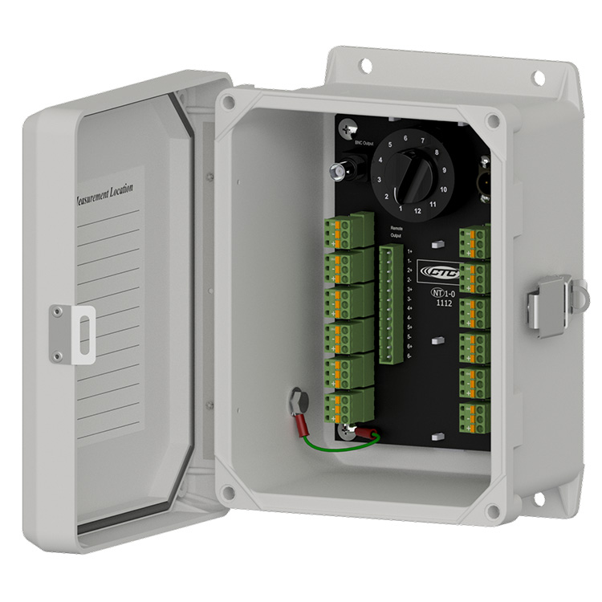
CABLE TERMINATION
The opposite end of the sensor cable needs to be organized and connected to portable or permanent vibration data collection.
Wiring should be well laid out and labeled with identification tags.
22 | LEVEL 3, LESSON 6 – MEASURING FAN AND MOTOR VIBRATION

Slide 22
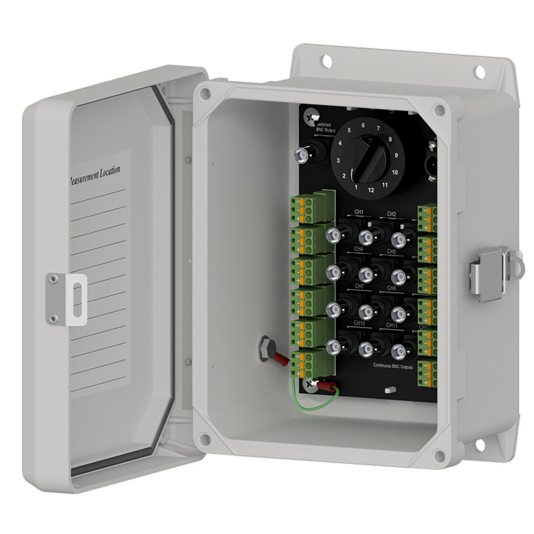
CABLE TERMINATION – PORTABLE DATA COLLECTION
Simple portable data collection with an individual sensor and portable mount usually takes care of itself by directly mounting to the data collector.
Using a portable data collector to measure permanently mounted sensors requires organization and termination of the sensor cables. A switch box is a convenient method.
23 | LEVEL 3, LESSON 6 – MEASURING FAN AND MOTOR VIBRATION

Slide 23
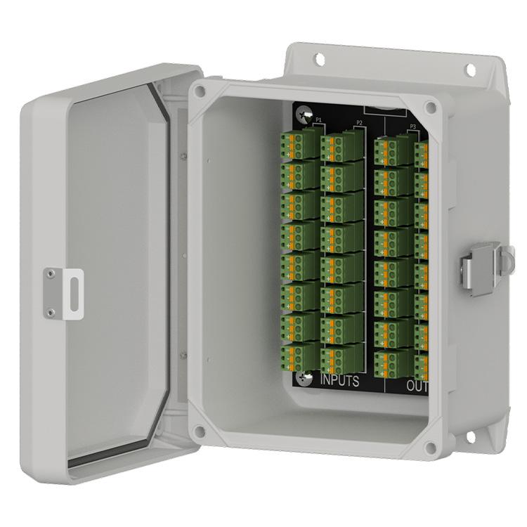
CABLE TERMINATION – PERMANENT DATA COLLECTION
Permanent monitoring also requires organization and termination of the sensor cables. These can be organized as individual cables or combined in a cable reduction box with a large multi-conductor cable.
24 | LEVEL 3, LESSON 6 – MEASURING FAN AND MOTOR VIBRATION

Slide 24
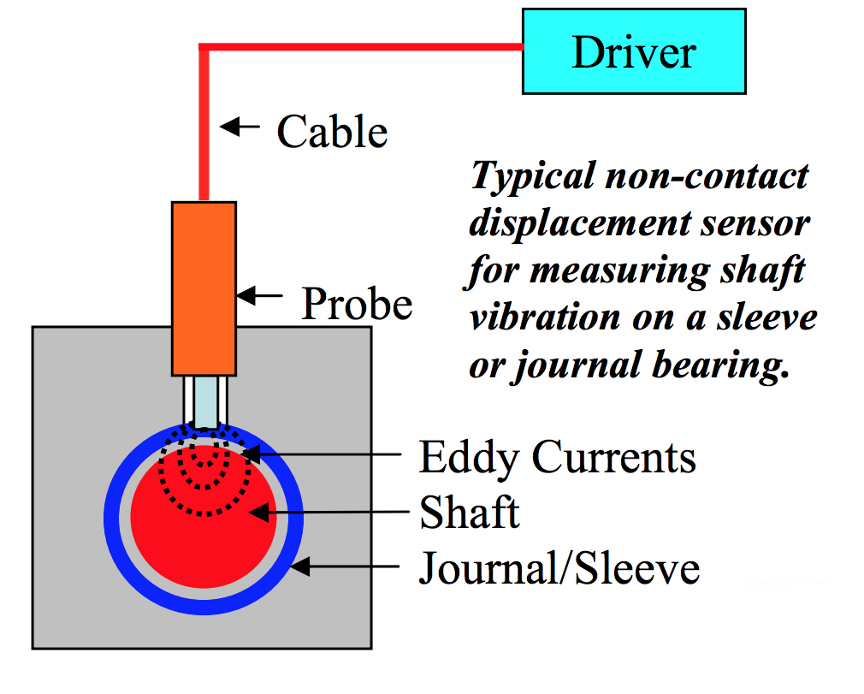
PLAIN BEARINGS
Some fans and motors are equipped with plain bearings. Plain bearings are often referred to as ”sleeve bearings” or “journal bearings.”
There are no rolling elements in a plain bearing, and typically the shaft is supported by a film or wedge of foil.
In most cases, the primary measurement is the movement of the shaft inside the journal or sleeve.
This type of measurement should be made with a displacement sensor (eddy current probe). These non-contact sensors provide valuable information on the shaft vibration, and the gap between the shaft and journal or sleeve.
25 | LEVEL 3, LESSON 6 – MEASURING FAN AND MOTOR VIBRATION

Slide 25
CONCLUSION
Vibration monitoring on fans and motors can be very beneficial. It doesn’t matter if it is route based portable measurements or permanent monitoring – both methods can achieve success in providing better reliability and improved performance for any predictive maintenance program.
Mechanical and electrical defects can be identified through vibration analysis. Choosing the correct sensor, mounting method, cable, and connector will provide quality data. Organizing the sensor wiring in a switch box or cable reduction box reduces measurement errors.
Operator safety should never be compromised. Permanent sensors and cables keep fingers and hands out of where they shouldn’t be!
Work safe, collect quality data, and enjoy the benefits of portable or permanent vibration measurement of your machines!
26 | LEVEL 3, LESSON 6 – MEASURING FAN AND MOTOR VIBRATION

Slide 26
THANK YOU!
Any queries?
Contact us:
sales@GTI.xyz
+92-xxxxxxxx

