Slide 1
INDUSTRIAL VIBRATION ANALYSIS FOR PREDICTIVE MAINTENANCE AND IMPROVED MACHINE RELIABILITY
LEVEL 3 – LESSON 5

Slide 2
OBJECTIVES
Upon completing the following lesson, you will understand how industrial vibration analysis is used to identify, predict, and prevent failures in rotating machinery in a variety of industrial environments.

Slide 3
BACKGROUND
Industrial vibration analysis is a measurement tool used to identify, predict, and prevent failures in rotating machinery.
Implementing vibration analysis on the machines will:
Improve the reliability of the machines
Lead to better machine efficiency
Reduce down time by eliminating mechanical or electrical failures
Vibration analysis programs are used throughout industries world wide to:
Identify faults in machinery
Plan machinery repairs
Keep machinery functioning for as long as possible without failure

Slide 4
INDUSTRIAL VIBRATION ANALYSIS - TYPICAL MACHINERY
Industrial vibration analysis is often used on:
Motors
Pumps
Gear Boxes
Compressors
Turbines
Conveyors
Rollers
Engines
Other machine tools that have rotational elements

Slide 5
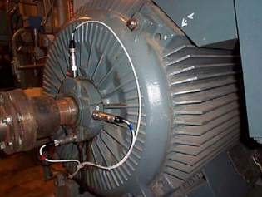
INDUSTRIAL VIBRATION ANALYSIS
The rotating elements of these machines generate vibrations at specific frequencies that identify the rotating elements.
The amplitude of the vibration indicates the performance or quality of a machine.
An increase in the vibration amplitude is a direct result of failing rotational elements such as bearings or gears.
Based on the machine speed, the rotational frequencies can be calculated and compared to the measurements to identify the failure mode.

Slide 6
INDUSTRIAL VIBRATION SENSORS
The practice of vibration analysis requires measurement and analysis of rotating machines utilizing different vibration sensors, including:
Accelerometers
Velocity Transducers
Displacement Probes
Accelerometers are the most common sensor used in industrial vibration monitoring

Slide 7
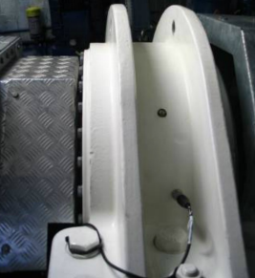
INDUSTRIAL VIBRATION SENSORS
Accelerometers are case mounted using a permanent bolt or portable magnet to hold them in place. They will measure the vibration of the machine and output a voltage or current proportional to the vibration and relative to a ”g” level (unit of gravitational pull). This signal can also be integrated to provide a measured output of velocity (inches / second or mm / second).
It is very important to choose the correct accelerometer, cable, connector, and mounting method for a specific application.

Slide 8
DISPLACEMENT PROBES
Sleeve bearing applications require displacement probes to measure the actual movement of the shaft inside the sleeve bearing.
These non-contact probes measure the vibration of the shaft and the gap between the shaft and the internal diameter of the bearing.
Using an eddy current process, these probes will provide an output voltage proportional to displacement (inches or mm).

Slide 9
VIBRATION ANALYSIS – WHAT FAULTS CAN BE IDENTIFIED?
There are several faults in rotating machinery that can be identified by measuring and analyzing the vibrations generated by a machine, including:
Machine out of balance
Machine out of alignment
Resonance
Bent shafts
Gear mesh disturbances
Blade pass disturbances
Vane pass disturbances
Recirculation and cavitation
Motor faults (rotor and stator)
Bearing failures
Mechanical looseness
Critical machine speeds

Slide 10
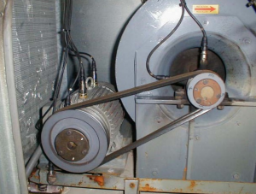
DYNAMIC VIBRATION ANALYSIS
The measurement and analysis of dynamic vibration involves accelerometers to measure the vibration, and a data collector or dynamic signal analyzer to collect the data.
Analysis is usually completed by a technician or engineer trained in the field of rotating machinery vibration.

Slide 11
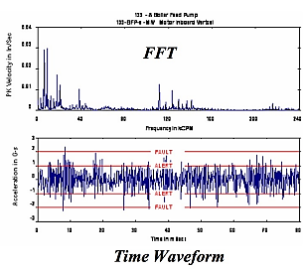
DYNAMIC VIBRATION ANALYSIS
The analog voltage output of the accelerometer, 100 mV/g, is measured by the data collector and presented as a time waveform and FFT (Fast Fourier Transformer) for frequency identification.
The plots of amplitude vs. time (time waveform) and amplitude vs. frequency (FFT) are required fore the trained technician or engineer to analyze and determine the machine fault.
Since each rotating element generates an identifying frequency, analyzing the frequency disturbances will identify the faulty element.
Once the fault is identified, parts can be ordered and repairs can be scheduled.

Slide 12
DYNAMIC VIBRATION ANALYSIS
Dynamic vibration analysis can be accomplished in several different manners:
Portable sensors and portable data collection following a predetermined route of machinery measurements
Permanent sensors and portable data collection following a predetermined route of machinery requirements
Permanent sensors and permanent data collection that provides machinery protection 24 hours per day, 7 days per week, 52 weeks per year.

Slide 13
PROCESS VIBRATION ALARMS
A recent development in the predictive maintenance and reliability market is to leverage the investment already made in process control systems (PLC, DCS, and SCADA).
This allows the operations, maintenance, and process control teams to monitor and alarm vibration levels on critical machines.
Using a standard 4-20 mA output, the loop power vibration transmitters and sensors provide a current output proportional to the overall value of the machine vibration.
This is not a dynamic analog signal, and it cannot be used to analyze the machine fault, but it can be used to alarm the machine and indicate when vibration levels are too high.

Slide 14
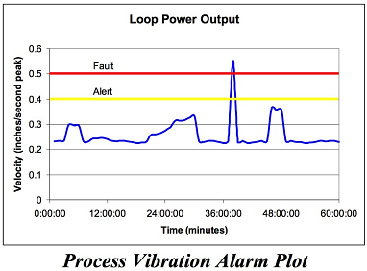
PROCESS VIBRATION ALARMS
When high vibrations are measured by the process control system, action can be initiated to determine the cause of the vibration or to shut the machine down to prevent damage or failure.

Slide 15
METHODS FOR ACHIEVING LOOP POWER 4- 20 mA OUTPUTS
METHOD 1:
A dynamic accelerometer with a 100 mV/g analog output can be connected to a transmitter.
The transmitter provides signal conditioning and a 4-20 mA current output proportional to the vibration.
It offers several different frequency filters to alarm the region of interest.
The dynamic signal, 100 mV/g, is also available for the trained technician or engineer to analyze.

Slide 16
METHODS FOR ACHIEVING LOOP POWER 4- 20 mA OUTPUTS
METHOD 2:
A loop power sensor with a direct 4-20 mA output can also be used.
This sensor does not require a transmitter, but the frequency filters are limited to 10 – 1000 Hz and 3 – 2500 Hz.
METHOD 3:
A dual output sensor with a direct 4-20 mA output and secondary 100 mV/g dynamic output can also be used.
This sensor does not require a transmitter, but the frequency filters are limited to 10 – 100 Hz and 3 – 2500 Hz.
It does have the dynamic signal, 100 mV/g, available for the trained technician or engineer to analyze.

Slide 17
METHODS FOR ACHIEVING LOOP POWER 4- 20 mA OUTPUTS
No matter what method you choose, standard 4-20 mA outputs proportional to machine vibration are available for process control.
This allows the factory to leverage typical process control monitoring methods and alarm schemes.
Convenient alarms for critical machines!

Slide 18
CONCLUSION
Vibration analysis is not a new technology. The Piezo effect and charge output of certain materials was discovered in 1880 by the Curies, and the first accelerometer was built in 1923.
Over the last 100 years, this technology has been refined for today’s industrial market to provide fast and efficient measurements of rotating machinery vibration.
Sensors are designed to withstand harsh industrial environments and provide critical measurements year after year.

Slide 19
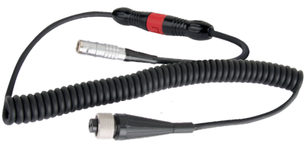
CONCLUSION
Cables and connectors are constructed of the most rugged materials available, and provide the critical link from the sensor to the data collector.
Designed for all types of environments, the proper cable and connector combination will eliminate any concerns for data transfer.

Slide 20
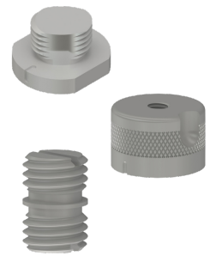
CONCLUSION
Mounting hardware is available for a broad range of applications. Measurements are accomplished quickly with portable magnet mounts or quick disconnects.
Permanent sensor installation can be accomplished with epoxy, stud mounting, or an array of special mounts designed for permanent applications.

Slide 21
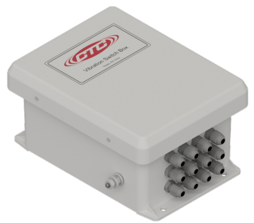
CONCLUSION
Junction boxes are extremely useful in collecting multiple cables and organizing them in a manner that protects them and makes them accessible to the user. They prevent tangled cables and identify each measurement point.

Slide 22
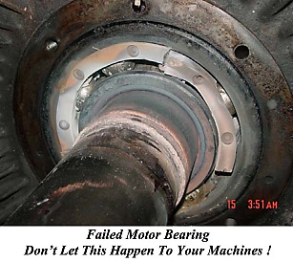
CONCLUSION
Dynamic vibration analysis or process vibration alarms will provide a proven technology to predict failures in rotating machinery and improve machine reliability.
Protect your investments by using industrial vibration sensors, cables, connectors, mounting hardware, and junction boxes to:
Measure
Analyze
Alarm
Repair

Slide 23
Thank you!
Any queries?
Contact us at:
sales@GTI.xyz
+92-xxxxxxx

